Slide 1
IAM Governance Processes for
DLT Consortia
Michael T. & Urmila N.
March 8 2023

Slide 2
Approach: What we have What we seek from your team
Michael T. & Urmila N.
March 8 2023

Slide 3
What we have

Slide 4
DLT Security Governance Framework Internal Audit Tool

Slide 5
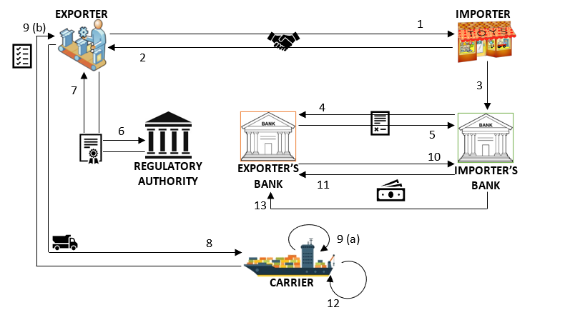
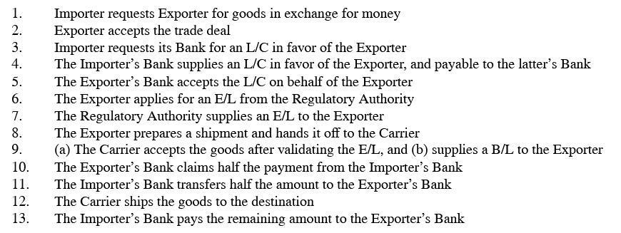
The Use Case: Trade Finance
Figure 1: Business Workflow Diagram for a Trade Finance Use Case
This use case is described in Hyperledger GitHub site https://github.com/HyperledgerHandsOn/trade-finance-logistics

Slide 6
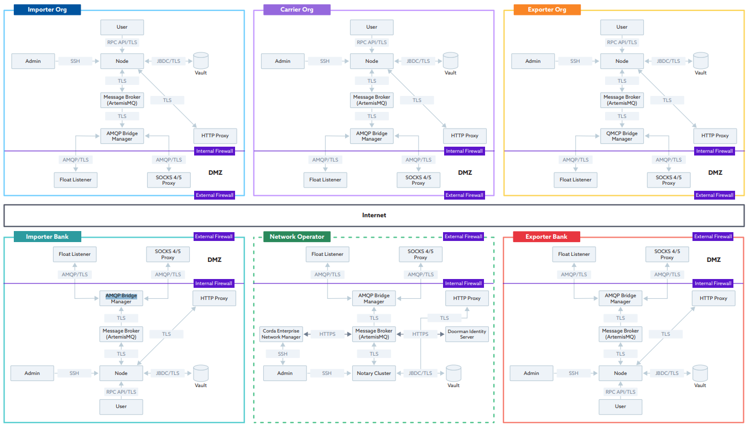
DLT Implementation of Trade Finance Use Case

Slide 7
ISO/IEC 38500:2008
STAKEHOLDERS
Trade Finance(TF) DLT Security Governance Framework
Trade Finance Regulators
Customers
Trade Finance Consortia
Financial Sector Regulators
Consortia Committee of CEOs
REPORT
DLT Governance Audit
Evaluate
Direct
Monitor
Importer Org
Exporter Org
Exporter Org Bank
Carrier Org
Network Operator
DLT Security Management System
Importer Org Bank
Source: Information Security Governance Framework
WISG’09, November 13, 2009, Chicago, Illinois, USA.
Copyright 2009 ACM 978-1-60558-787-5/09/11
Notes:
three common parts with ISO/IEC38500 Information Technology Governance Framework; “Direct” for guiding managements from the viewpoints of business strategies and risk management,
“Monitor” for ensuring the governance activities visible with measurable indicators,
“Evaluate” for assessing and verifying the results/outcomes.

Slide 8
DLT Security Governance Framework’s Two Main Components
Modeled on FFIEC CAT’s Inherent Risk Profile
Modeled on NIST CSF Core Functions
DLT Inherent Risk Profile
Business Objectives●Threat Environment ●Response Readiness●Design Constraints
Identifies Consortia’s inherent DLT Risks before implementing controls
DLT SMS Core
Identify●Protect●Detect●Respond●Recover
5 Functions provide a high-level, strategic view of the lifecycle of a Consortia’s management of DLT cybersecurity risk

Slide 9
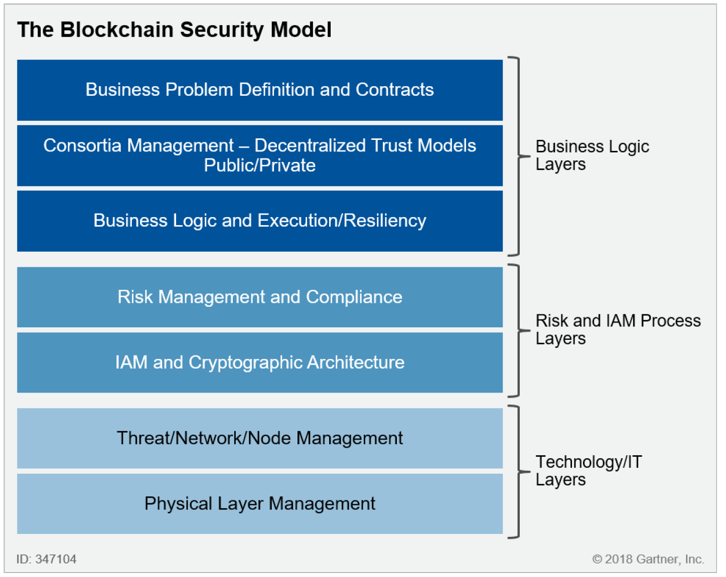
Gartner’s DLT Layers
DLT Inherent Risk Profile
Source: Gartner, Gartner. (2018). Evaluating the Security risks to Blockchain Ecosystems. (ID:G003247104)
Note: Gartner’s Blockchain Security Model is applicable to DLTs and Blockchains

Slide 10
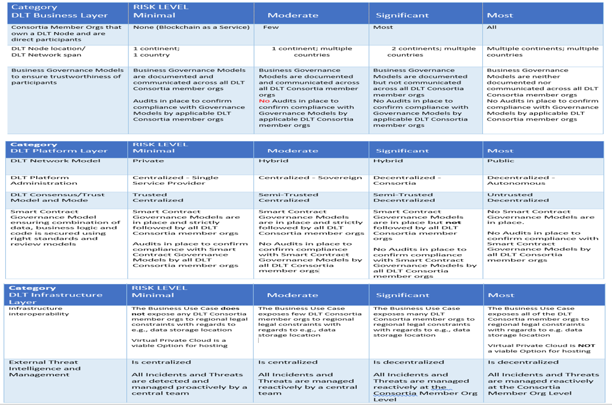
DLT Inherent Risk Profile based on 3 DLT Layers

Slide 11
DLT SMS Core
Gartner’s DLT Layers
IDENTIFY
PROTECT
DETECT
RESPOND
RECOVER
Source: Gartner, Gartner. (2018). Evaluating the Security risks to Blockchain Ecosystems. (ID:G003247104)
Note: Gartner’s Blockchain Security Model is applicable to DLTs and Blockchains

Slide 12
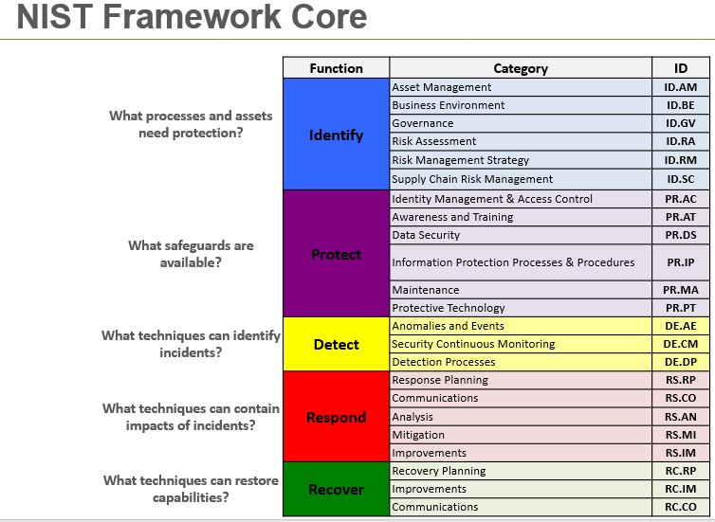
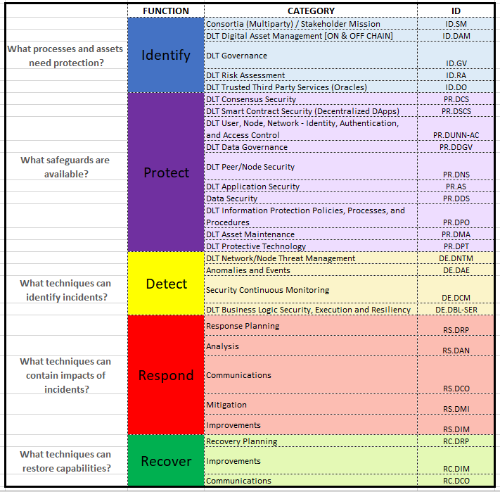
DLT SMS Core

Slide 13
What we seek from your team

Slide 14
DLT SMS Core
Seeking Expert Opinion on enhancing security recommendations for the following Categories
DLT Smart Contract and Application Security
DLT User, Node, Network IAM
DLT Network/Node Threat management
Anomalies & Events
Link to DLT SMS Core
https://docs.google.com/spreadsheets/d/1iJ9yvX7JMCunld10ct-ickhTfg4TDPFR/edit?usp=share_link&ouid=115467577721694574077&rtpof=true&sd=true

Slide 15
Cryptography in Blockchains / DLTs
For blockchain / DLT, cryptography plays a central role in delivering immutability, consensus, transaction signing and verification, data synchronization, and more.
Cryptography allows for mining in the cases of Bitcoin and Ethereum, faster synchronization of transaction information between nodes of a blockchain / DLT, airtight transaction integrity and—probably the most important and revolutionary—double-spend protection, where a party receiving a digital asset is assured it wasn’t also transferred to one or more other parties.
When it comes to blockchain / DLT, cryptography is used in a number of ways, but the two fundamental techniques are hashes and asymmetric keys. Both of these are instrumental in providing blockchains / DLTs the firepower they need to ensure data integrity, data privacy, and immutability and combat double spend and prevent and detect tampering of transactions.
Also, certain additional techniques or data structures, like digital signatures, digital certificates, and Merkle trees, are deeply embedded in most blockchains.

Slide 16
Key & Digital Cert Management
User Level – End Point Key Management
Application Level – API Key Management
Platform Level –
Transaction Key Management
Smart Contract Validation Key Management
Note: smart contract is automated coded business logic.
Due to its high impact profile it needs to be validated by member orgs participating in the transaction prior to execution
Infrastructure Level –
Participating Peer Node Key Management
Validating Node Key Management
Communication Channel SSL/TLS key management

Slide 17
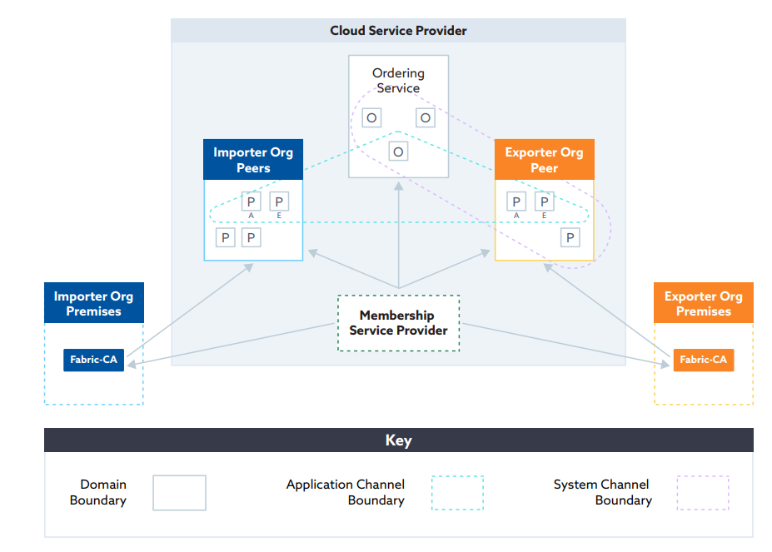
Extending Digital Certificate Authority a.k.a Membership Service Provider to Member premise (Fabric-CA) example: Hyperledger Fabric
Digital certs are required at System Level for:
Peer Node authorization
At User Level for:
Transaction Creation
Transaction Approval
Transaction Validation
Fabric-Certificate authority (Fabric-CA) at each Member’s premise generates the digital certs for its 1) peer nodes and its 2) Users

Slide 18
Blockchain/ DLT Transaction Security Requirements
Transaction Privacy or Anonymity – Blockchain / DLT user’s ability to take part in multiple transactions without the transactions being traced back to the user
Digital Signature Unforgeability or Security – Blockchain / DLT user being able to facilitate secure payments, transfers and holding of assets via digital signatures (using private/secret key) without running the risk of the signature being forged

Slide 19
Seeking Expert Opinion
How do we secure a Blockchain / DLT system when one or more of the Consortia member orgs opt for using external third party ID-Cert service provider instead of the native Certificate Authority offered by the Blockchain / DLT system
What recommendations do we propose for securing
API Call Key management
SSL/TLS Key management
Smart contract Validation Key management

