Slide 1
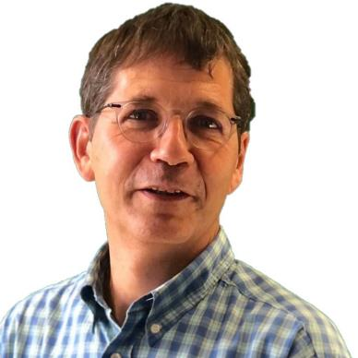
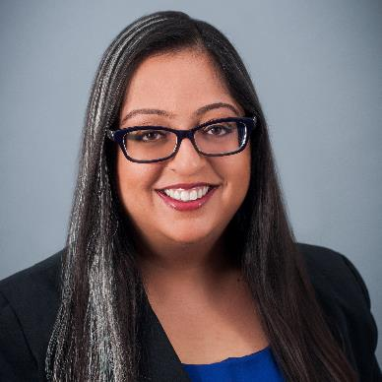
Quantum-Safe Security Working Group
Call: April 23rd , 2024
Visit our webpage:
https://cloudsecurityalliance.org/research/working-groups/quantum-safe-security/
And on LinkedIn:
https://www.linkedin.com/company/quantum-safe-security-working-group/
Bruno Huttner; QSS co-Chair
Mehak Kalsi; QSS co-Chair
Bruno.Huttner@idquantique.com
mkalsi005@gmail.com
https://www.linkedin.com/in/bruno-huttner
https://www.linkedin.com/in/mehakkalsicisspcisa/

Slide 2
Agenda:
C SA News: Hillary
Update on current activities
Update on current documents
News from Quantum-Safe space
Events
AOB

Slide 3
Updates on current activities (1)
Logistics: Make sure to sign up for our Google calendar meeting series on Circle to get updates.
Comment on the new position paper from the 4-agencies...
Proposal: series of blogs (TBC)
Apple Using PQ3 for iMessage – Any volunteers... (TBC)
Quantum Physics 101 – standard introductory paragraph(s)
Collaboration with Cloud Key Management Group
The CSA Cloud Key Management working group is thinking of creating a document on 'Post-Quantum Cryptography Key Management with procedural steps on crypto-migration'
We would like your feedback on whether: Your working group has or is already covering a relevant topic and if not, what do you think would add value to have included in a topic as this.
Crypto Newsletter, April 2024: posted on LinkedIn
https://www.linkedin.com/feed/update/urn:li:activity:7180300818770731008

Slide 4
Updates on current documents
In Progress:
Security controls / Quantum Risk Matrix (Pius, John, Nuno): Meetings on Fridays, In Progress
AI and Quantum article (Mehak, Bruno, John, Edward): Framework available: https://circle.cloudsecurityalliance.org/discussion/reviewers-needed-quantum-and-ai-paper-outline ; In Progress
Paused:
Update of our white paper on Blockchain (Shamik)
QKD & PQC (Bruno)

Slide 5
News from Quantum-Safe
Breakthrough in Quantum Cloud Computing Ensures its Security and Privacy
https://www.techrepublic.com/article/quantum-cloud-computing-security-privacy/
“Oxford University researchers used an approach dubbed “blind quantum computing” to connect two quantum computing entities in a way that is completely secure.”
How? They are stating that with “blind quantum computing” the user will remotely control the quantum processor of the server rather than relying on the cloud provider.
A client computer would need to be able to detect photons which would be connected to a quantum computing server with a fibre network and received by the client.
It is stated that tampering would not impact the security of the data, however, it could corrupt the result and client would not know about it.
Research was funded by the UK Quantum Computing and Simulation Hub (collaboration of 17 universities) which is one of four quantum tech hubs in the UK National Quantum Technologies Programme.

Slide 6
Events
Day of Shecurity, Virtual and San Francisco, CA, April 25 – 26, 2024
https://events.securediversity.org/dos-april-2024/home
Quantum.Tech, Washington DC, April 25 - 26, 2024
https://www.alphaevents.com/events-quantumtechus
RSA Conference, San Francisco, CA, May 6-9, 2024
https://www.rsaconference.com/usa
10th ETSI/IQC Quantum Safe Cryptography Conference, Singapore, May 14 – 16, 2024
https://www.etsi.org/events/2284-10th-etsi-iqc-quantum-safe-cryptography-event
IEEE Quantum Week 2024 in Montréal, Sept 15-20, 2024
https://qce.quantum.ieee.org/2024/

Slide 7
AOB
Next Call: May 7, 2024

Slide 8
Thank you!
Mehak Kalsi
Bruno Huttner
The goal of the Quantum-Safe Security (QSS) working group is to support the quantum‐safe cryptography community in development and deployment of a framework to protect data whether in movement or at rest.
Visit our webpage:
https://cloudsecurityalliance.org/research/working-groups/quantum-safe-security/
The document will be available on Circle after the call
Bruno.Huttner@idquantique.com
mkalsi005@gmail.com
Contact us:
Bruno Huttner and Mehak Kalsi, co-Chairs
Hillary Baron, CSA Program Manager
https://www.linkedin.com/in/mehakkalsicisspcisa/
https://www.linkedin.com/in/bruno-huttner

