Slide 1
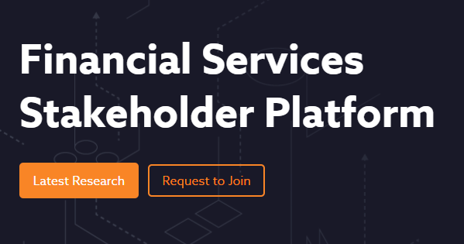
Meeting Agenda
CSA Events and Updates
Threat detection & response virtual workshop - May 26th
API MythBusters: Crushing Five Security Myths that are Crushing Your Safety - June 2nd
RSA Conference 2022 - June 6th-9th
SECtember 2022 - September 26th
Zero Trust Advancement Center
Advancing Zero Trust Principles - May 26th
A Guided Approach to Support Your Zero Trust Strategy - June 29th
CSA Peer Reviews and Surveys, Research Releases
Cloud Usage in the Financial Services Sector v2
Draft - Reevaluate the previous Cloud Usage in the Financial Services Sector publication with an updated version focusing on relevant topics for the modern financial services industry landscape
Financial security startup company evaluations

Slide 2
Research Peer Reviews, Surveys, and Recent Releases
CSA Peer Reviews and Surveys
Third-Party Vendor Risk Management - June 13th
Recent Research Releases
Best Practices for Smart Contract Security Hyperledger Fabric - May 16th
HPC Cloud Services Onboarding Guide - May 16th
Healthcare Supply Chain Cybersecurity Risk Management - May 11th
Guide to the IoT Controls Matrix v3 - April 25th
IoT Controls Matrix v3 - April 25th

Slide 3
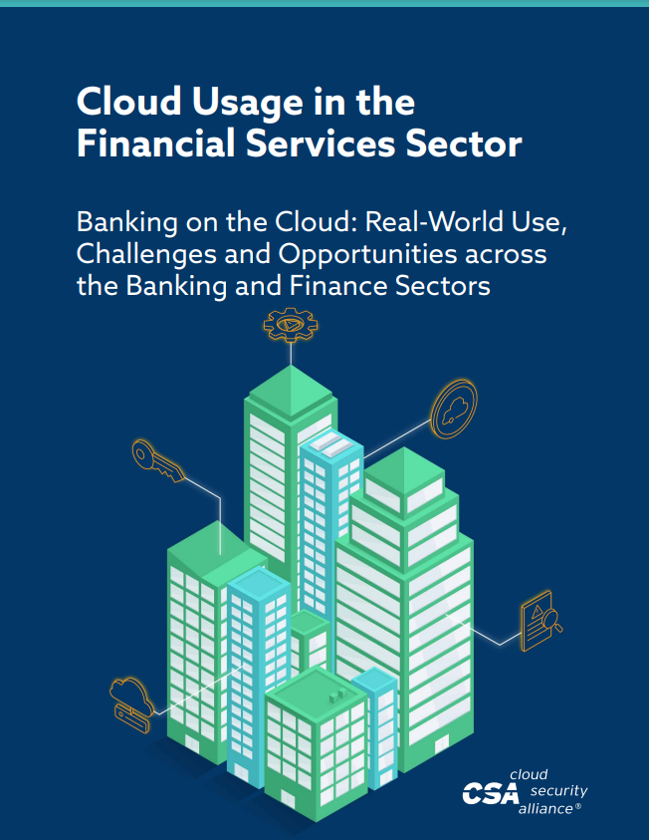
Financial Services Research in Development
Cloud Usage in the Financial Services Sector v2
Draft - Reevaluate the previous Cloud Usage in the Financial Services Sector publication with an updated version focusing on relevant topics for the modern financial services industry landscape
Domains for the next survey in progress:
Data privacy/sharing
Vendor risk assessments
Encryption/key
Secrets lifecycle management
Compliance infrastructure for SaaS/PaaS decentralized environments
Application/ Ops
Agile Maturity
BCP: region migration
SOC: logging/visibility/response
SaaS integration with SOC
Financial security startup company evaluations
Proposal - Have 30 minutes of each monthly call for a working session, and 30 minutes for a “shark tank” style session with security companies having 10 minutes to pitch and receive feedback
Could be a way to increase participation from Financial Institutions

Slide 4
Next Meeting
June 22nd 8:00 AM PT
https://cloudsecurityalliance.zoom.us/j/94151107820
Agenda, guest speaker TBA
Cloud Usage in the Financial Services Sector v2 development
Financial Services research publications from CSA website
Participate in Research open peer reviews and surveys on CSA website

