Slide 1
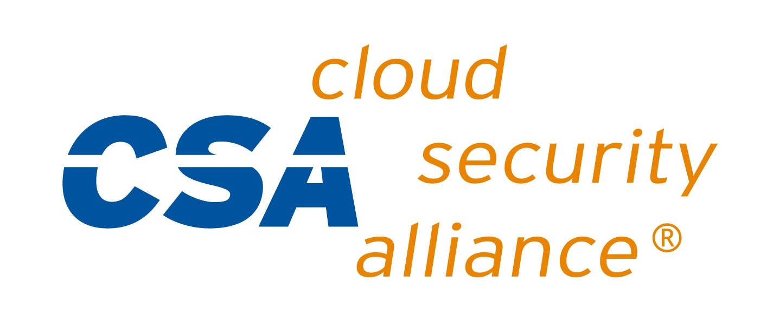
Meeting Agenda
CSA Events and Updates
CSA ASEAN Summit 2022 - August 4th - 5th
ATARC 2022 Zero Trust Summit - August 9th
Black Hat USA 2022 - August 10th- 11th
Cyversity Engage | A Step Towards Continuous Trust - August 24th
SECtember 2022 - September 26th- 30th
Zero Trust Advancement Center Events
Top 5 Zero Trust Practices to Stop Modern Attacks - August 24th
The role of zero trust in improving corporate governance and compliance - September 14th
Zero Trust Summit - November 16th - 17th
CSA Research Peer Reviews, Surveys, and Releases
Poll group for a new Financial Services meeting time
Cloud Change Management for initiated changes
Cloud Usage in the Financial Services Sector v2
Financial security startup company evaluations

Slide 2
Research Peer Reviews, Surveys, and Recent Releases
CSA Peer Reviews and Surveys
Recommendations for using a Customer Controlled Key Store - August 12th
Healthcare Interoperability - August 8th
Sensitive Data in the Cloud (Survey) - July 12th
Recent Research Releases
Third-Party Vendor Risk Management - July 19th
CSA CCM v4.0 Addendum - CRI FS Profile v1.2 - July 15th
Critical Controls Implementation for Oracle Fusion Applications - July 12th
State of ICS Security in the Age of Cloud - July 5th
Measuring Risk and Risk Governance - June 21st

Slide 3
Financial Services Research in Development
Cloud Change Management for initiated changes
CSP-initiated changes that result in vulnerabilities
CSA Global Security Database (GSD)
Meant to be a fast, cooperative, royalty free, and public collection of security information.
The project uses the open source model to overcome many of the existing shortcomings of security databases such as being difficult to access, update, and restricted use of the security information.
Cloud Usage in the Financial Services Sector v2
Draft - Finalize draft, ready for Peer Review?
Financial security startup company evaluations
Proposal - Have 30 minutes of each monthly call for a working session, and 30 minutes for a “shark tank” style session with security companies having 10 minutes to pitch and receive feedback
Could be a way to increase participation from Financial Institutions

Slide 4
Next Meeting Agenda
August 24th 8:00 AM PT
https://cloudsecurityalliance.zoom.us/j/94151107820
Provide an overview of the CRI control framework, the CCM/CRI mapping and the recently published CSA CCM v4.0 Addendum - CRI FS Profile v1.2 for financial services
Cloud Usage in the Financial Services Sector v2 development
Financial Services related research publications from CSA website

