Slide 1
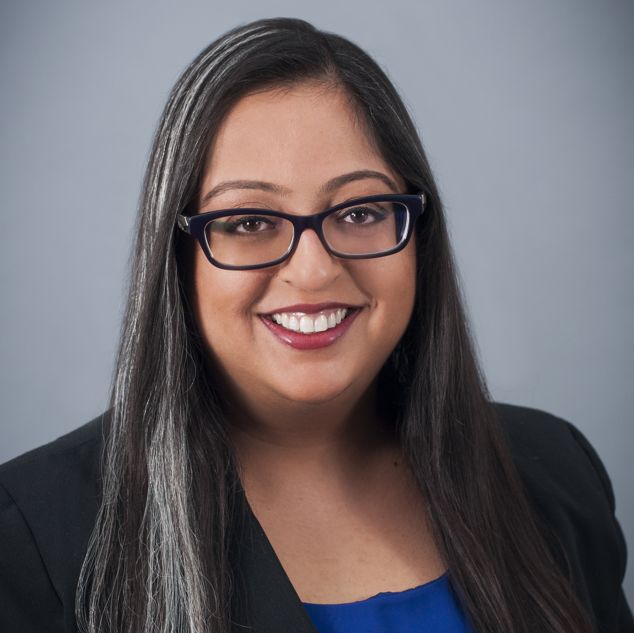
Quantum-Safe Security Working Group
Call: May 23rd 2023
Visit our webpage:
https://cloudsecurityalliance.org/research/working-groups/quantum-safe-security/
And on LinkedIn:
https://www.linkedin.com/company/quantum-safe-security-working-group/
Bruno Huttner; QSS co-Chair
Mehak Kalsi; QSS co-Chair
Bruno.Huttner@idquantique.com
mkalsi005@gmail.com
https://www.linkedin.com/in/bruno-huttner
https://www.linkedin.com/in/mehakkalsicisspcisa/

Slide 2
Agenda:
CSA News: Hillary
Update on current activities
Update on current documents
News from Quantum-Safe space
Events
AOB

Slide 3
Updates on current activities
LinkedIn (Denis)
https://www.linkedin.com/company/quantum-safe-security-working-group
Monthly / Bi-Monthly Articles:
Mass Adoption of Quantum Computers (Cory): Under review
New PQC Legislation for Financial Organizations (Denis): Planning
Any ideas for our next one?
Bruno suggested recent news related to Kyber for those who are more technically inclined.

Slide 4
Updates on current documents
In Progress:
Quantum & Forensics (Roger) Real progress this time...
Update of our white paper on Blockchain (Shamik)
Paused:
Security controls / Quantum Risk Matrix (Ashish, Pius, Cory) – Update from Hillary.
QKD & PQC (Bruno)
C-Suite Preparedness for Post-Quantum World – Update of existing materials (Vasu)

Slide 5
Update on current documents: Quantum Forensics
White paper on Quantum Forensics:
How Quantum Changes Computer Forensics
Traditional computer forensics is all about making exact copies of memory and hard drives, but what do you do when the physics involved absolutes prevents you from getting an exact copy? How does quantum physics change computer forensics and how can future computer forensics be performed on quantum computers and devices? Read this whitepaper to learn about the impact quantum physics has on computer forensics and what no longer works, what needs to change, and what has to be invented?
New draft available shortly

Slide 6
Update on current documents: white paper on Blockchain
First draft available, need reviewers!
“Challenges for Transitioning of Blockchains to Quantum-Safe Cryptography”

Slide 7
News from Quantum-Safe
News from Arqit...
Arqit is disengaging from satellites for QKD and expect to sell the satellite activities
They have a cloud delivered, all software Symmetric Key Agreement Platform as a Service...
Arqit launches sale of satellite division - SpaceNews

Slide 8
Events
IQT Canada, Montreal ; June 20-22 ; https://iqtevent.com/canada Meet Gilles Brassard there...
Black Hat, Las Vegas, Nevada, USA, August 5-10 https://blackhat.com
Def Con 31, Las Vegas, Nevada, USA, August 10-13 https://defcon.org/
Grace Hopper Celebration, Orlando, September 26-29 https://ghc.anitab.org/
InfoSec World, Orlando, September 25-27 https://www.infosecworldusa.com/

Slide 9
AOB

Slide 10
Thank you!
Mehak Kalsi
Bruno Huttner
The goal of the Quantum-Safe Security (QSS) working group is to support the quantum‐safe cryptography community in development and deployment of a framework to protect data whether in movement or at rest.
Visit our webpage:
https://cloudsecurityalliance.org/research/working-groups/quantum-safe-security/
The document will be available on Circle after the call
Bruno.Huttner@idquantique.com
mkalsi005@gmail.com
Contact us:
Bruno Huttner and Mehak Kalsi, co-Chairs
Hillary Baron, CSA Program Manager
https://www.linkedin.com/in/mehakkalsicisspcisa/
https://www.linkedin.com/in/bruno-huttner

