Slide 1
Birds of a Feather Blockchain Discussion
Alex Kaluza - Research Coordinator/Analyst
Sean Heide - Research Analyst

Slide 2
Meeting Agenda
Brief History
Use Cases/ General Discussion
Security Concerns- Two facets of blockchain risk

Slide 3
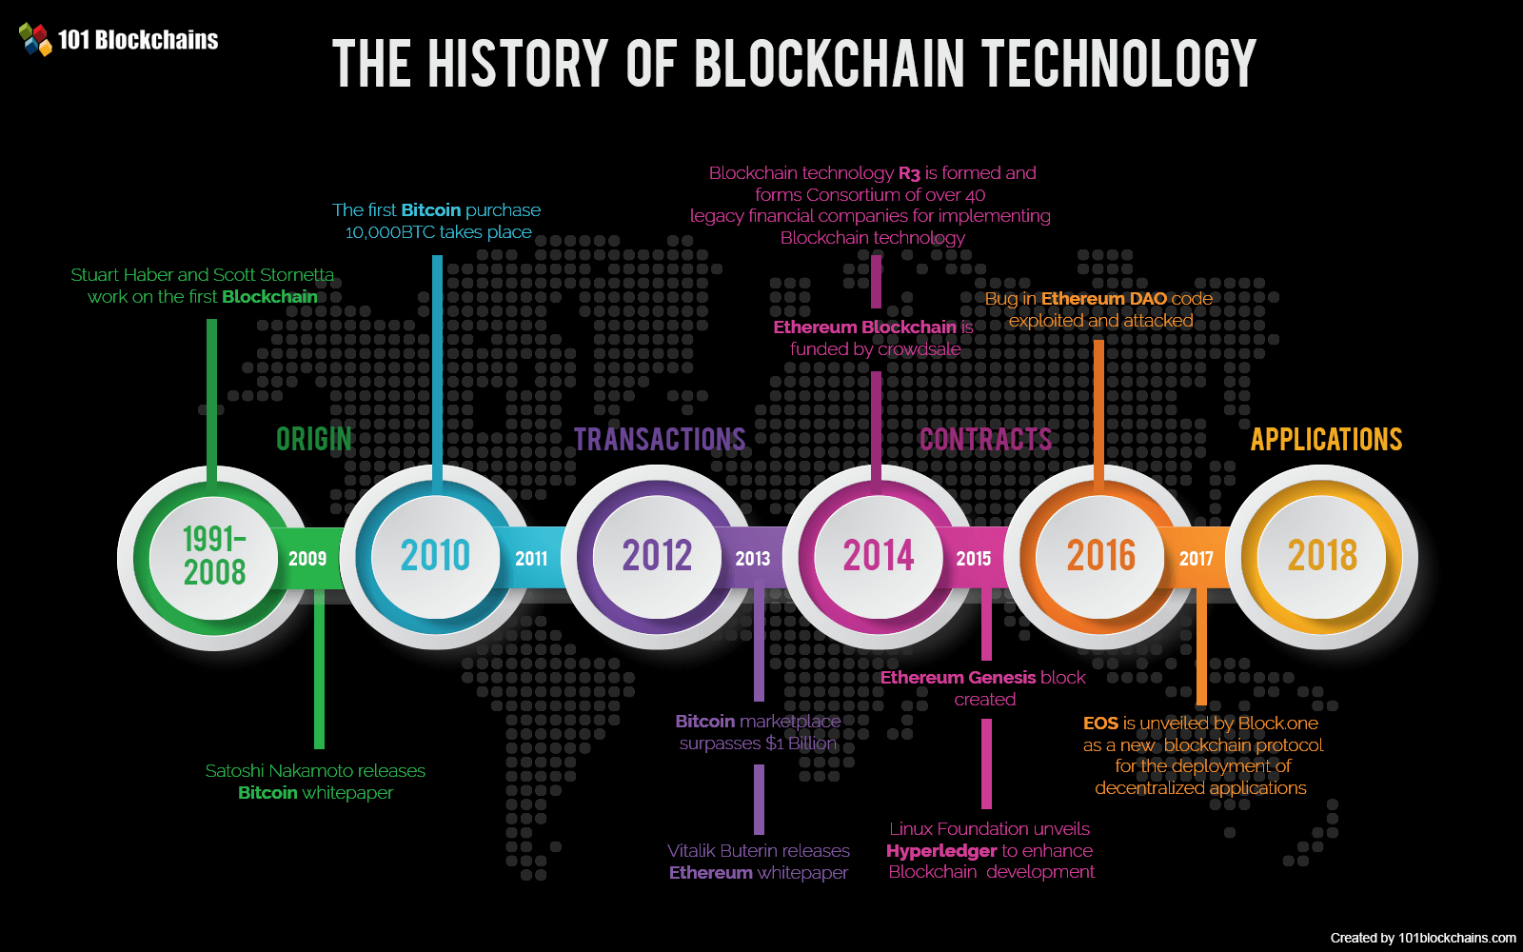
History
In 1991 Stuart Haber and Scott Stornetta began work on cryptographically secured chains of blocks whereby no one could tamper with time stamped documents.
Satoshi Nakamoto conceptualized the first blockchain in 2008, and released the whitepaper in early 2009.
Soon after, early supporters began exchanging and mining Bitcoin. By late 2011 and in following years, many alternative cryptocurrencies in the public and private sector began to emerge.

Slide 4
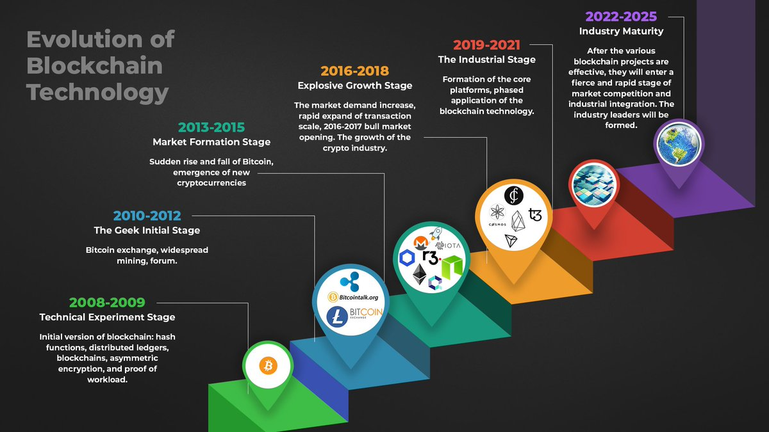
History
In 2013 as an early developer to the Bitcoin codebase, Vitalik Buterin began working on a more flexible blockchain that had increased functionality to Bitcoin.
Ethereum was crowd sale funded and launched in 2015 as an open source blockchain platform which allows the development of decentralized applications primarily through the use of smart contracts.
Ethereum allowed for an explosive growth of tokens created on it’s blockchain, utilizing the ERC-20 standard protocol.

Slide 5
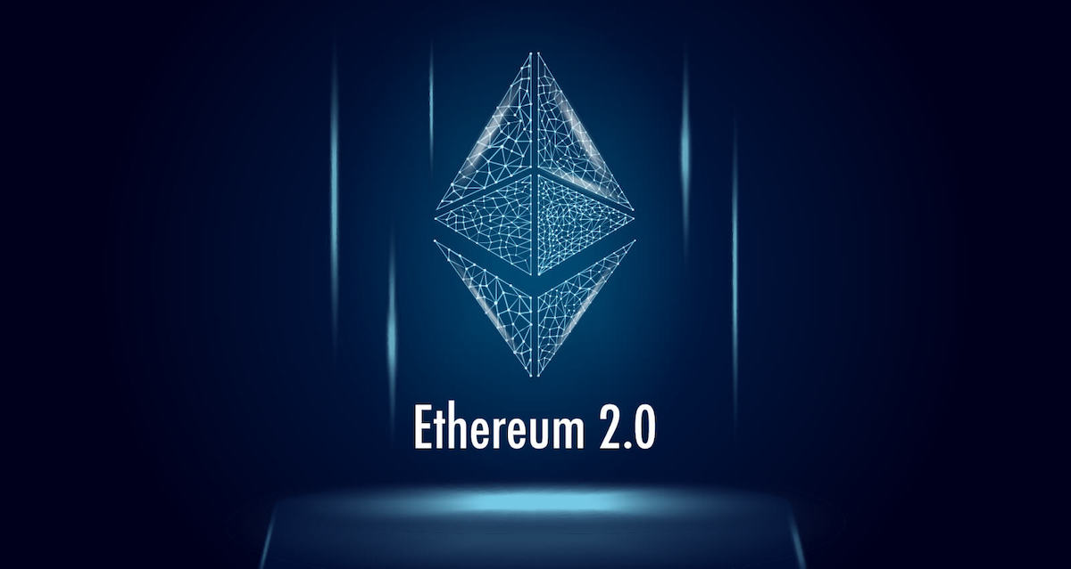
History
Additional blockchains and cryptocurrencies focused on security, development support, and transaction speeds continue to launch and compete. The vast majority of the development and use of decentralized apps still resides on Ethereum, causing increased network congestion.
Recently on December 1st, 2020, the Genesis Block for Ethereum 2.0 was launched, running in parallel to Ethereum. Ethereum 2.0 uses a Proof of Stake consensus algorithm, and will include sharding, which is designed to support a much larger number of transactions per second.

Slide 6
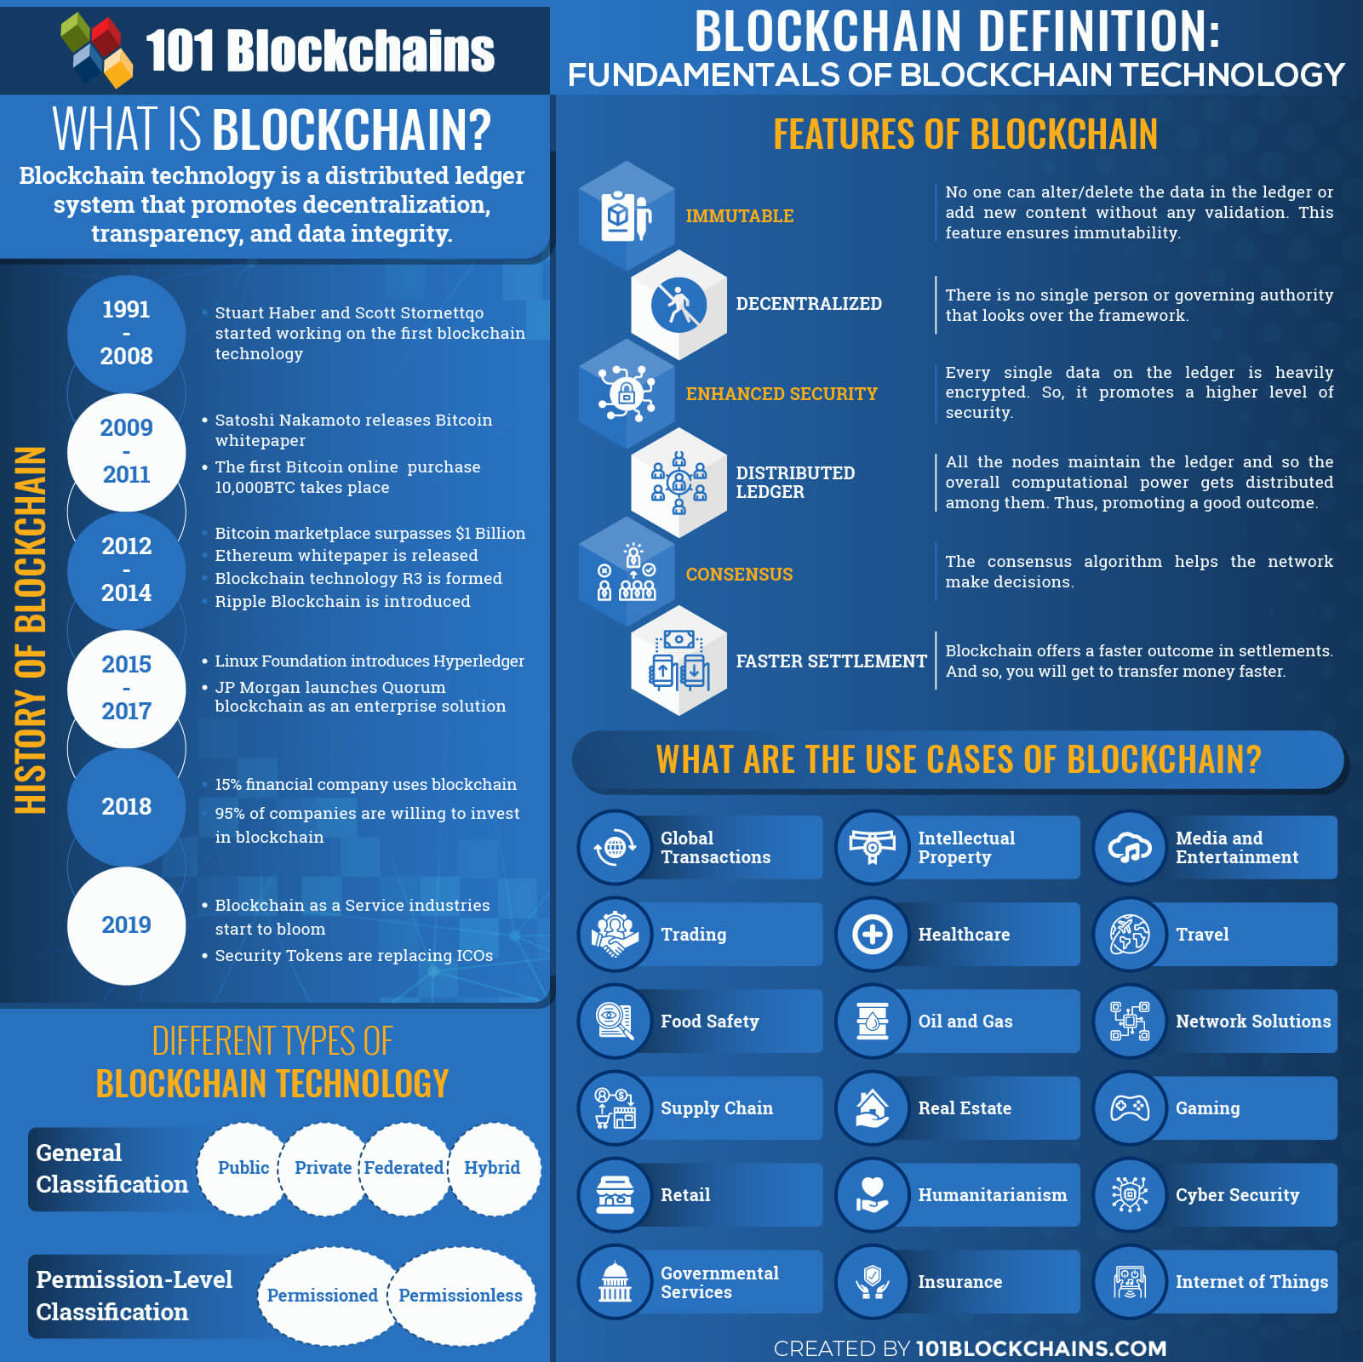

Slide 7
Blockchain Use Cases
Cryptocurrencies
Medium of exchange where ownership is stored in a ledger
Identity and Asset Management
Verify and authenticate access
Supply Chain & Logistics
Real-time IoT operating systems
Energy & sustainability
Real-time data management, carbon crediting system
Government & Voting
Ensure fraud protection in voting systems
Bounty programs
Bounty programs for threat intel research and evaluation of malware

Slide 8
Blockchain Use Cases
Healthcare & Life Sciences
Secure sharing of personal medical data
Traditional Finance
Cross border payments, safety and efficiency handle transaction processing, anti-money laundering tracking
DeFi
Self-custodial financial applications and protocols that don’t rely on traditional financial institutions, decentralized exchanges
Real Estate
Tokenized real estate assets representing a share in property, tracking investments, limit risk of fraud
Media & Music Royalties
Efficiently pay artists, prevent counterfeit tickets.

Slide 9
So where does cloud fit in?
BaaS
Hosted nodes
Data storage
Push and Pull
API development
“Off-Chain” factor

Slide 10
Blockchain Security Concerns
Even though the underlying blockchain technology is encrypted and forever on the blockchain, there are still privacy and security concerns to consider. For instance, the underlying data, or the original copy, is stored on cloud servers in order to meet the demands for space, redundancy, and availability
Exchange hacks, malicious crypto mining, malware, keyloggers, ransomware, Social Media scams, etc

Slide 11
Blockchain Security Concerns
Hosted services for exchanges- Recent downtime for KuCoin etc.
There will be a need for expertise in these areas as blockchain grows. Not just for developers in the space, but cloud architects who can help create regional redundancy for mass amounts of users.
If there is a downtime of a specific regional exchange, this could very well mean downtime for specific projects running on those same instances. Depending on the scope of the project (threat intel) this can lead to a significant up time issue if not properly configured.
How is it used in regards to cloud usage?
Misconfigured interfaces
Exposed API’s
Kubernetes consoles misconfigured
Malicious docker images
Where the trends are pointing in cloud security i.e. need for controls, authentication methods

Slide 12
Blockchain in Use

Slide 13
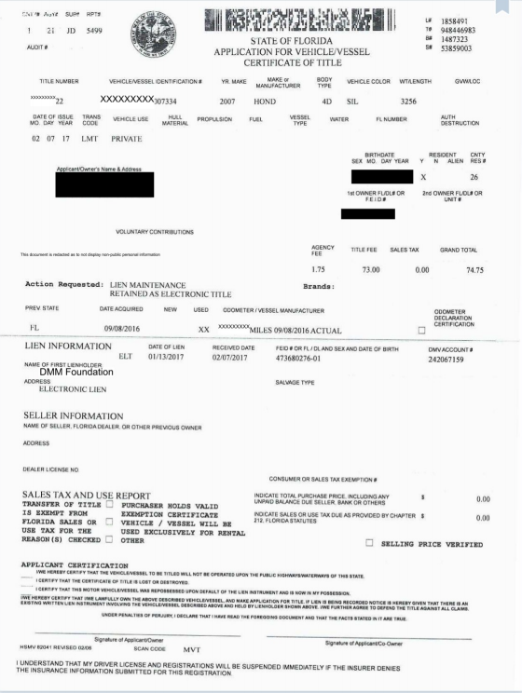
Blockchain in Use

Slide 14
Where Does the Future Lie
Steady increase in Oracle production
Large threat intel/ CVE identification database
Is this the next dotcom bubble?
Will this ever replace traditional file/ cloud storage?
Know what data you need to put into a block
Better classification models for oracles to aggregate data from cloud providers
Audit of Oracle providers (as seen in the Chainlink white paper)
Circle Blockchain Working Group

