Slide 1
Automotive Cloud
Attack Flows

Slide 2
Background
Auto manufacturers implementing applications with built in interactive modules/systems and cloud connectivity
TARA (e.g., ISO/SAE 21434) includes attack path analysis to identify paths an attacker may take to realize a threat scenario
A tailorable vehicle-focused attack path library can be used by OEMs and Suppliers to quickly select and model attacks against threat scenarios
Focused on intersection of automotive and cloud

Slide 3
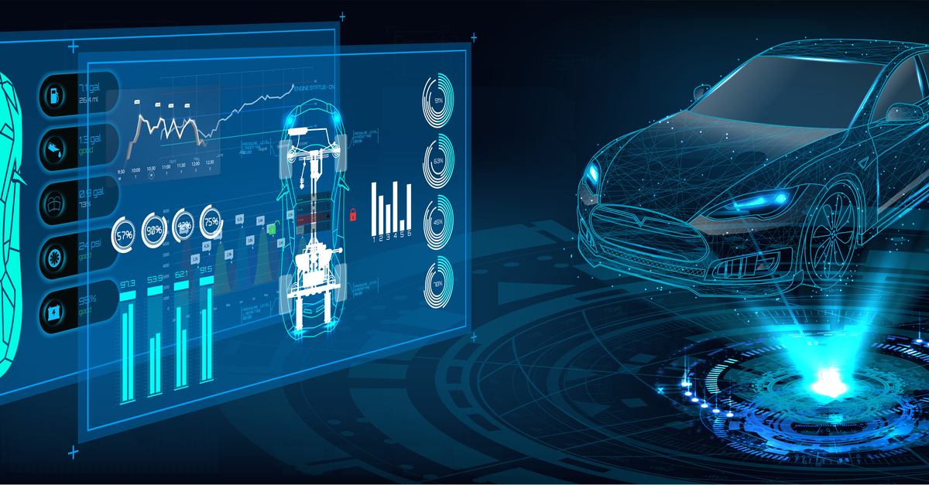
Automotive Cloud Services
Cloud processes or stores:
Vehicle Telematics Data: Vehicle's speed, location, fuel consumption, mileage, engine status, tire pressure, etc.
Connected Vehicle Data: Data from infotainment systems, navigation systems, and vehicle-to-everything (V2X) communication systems is sent to the cloud. This data includes real-time traffic information, weather updates, driver preferences, and usage patterns for connected services.
Vehicle Diagnostics Data: This includes data from the vehicle's onboard diagnostic (OBD) system, which monitors the performance of various vehicle components. Diagnostic data is used for remote diagnostics, predictive maintenance, and warranty management.
Sensor Data: Automated vehicles use a variety of sensors, including LiDAR, radar, ultrasonic sensors, and cameras, to perceive their environment. This sensor data is crucial for obstacle detection, lane-keeping, and other autonomous driving functions. Some of this data is sent to the cloud for analysis and model training.
Event Data: event data recorders (EDRs) may capture data related to vehicle speed, acceleration, braking, airbag deployment, and more.
Driving Behavior Data: Data related to driving patterns, such as sudden braking, acceleration, turning, and lane-changing, is captured and analyzed to understand driver behavior and enhance safety systems or provide feedback to drivers.
Software Update Data: Over-the-air (OTA) software updates are becoming more common in the automotive industry. Cloud services are used to deliver software updates to the vehicle's infotainment system, control modules, or autonomous driving systems.
Traffic and Map Data: Real-time traffic data, road conditions, and high-definition map data are stored in the cloud and accessed by connected and automated vehicles for route planning and navigation.
Customer Interaction Data: OEMs and dealers use cloud-based CRM (Customer Relationship Management) systems to store data related to customer interactions, including sales inquiries, service appointments, etc…

Slide 4
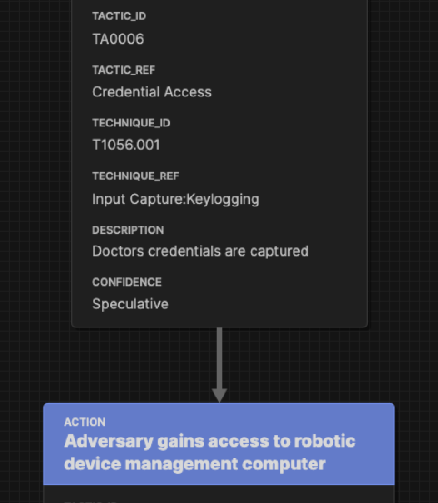
Project Scope
Library of attack paths/trees tailored to automotive cloud services and mapped to specific damage scenarios.
Attack paths consistent with inputs required for threat analysis and risk assessment process and in line with ISO/SAE Work Product (WP)-15-05
Attack paths developed in machine-readable format for potential use in attack simulations; aligned with MITRE attack flow notation.
Integration of attack path analysis into threat analysis and risk assessment package
Attack paths developed based on (1) review of known exploits and (2) theoretical exploits

Slide 5
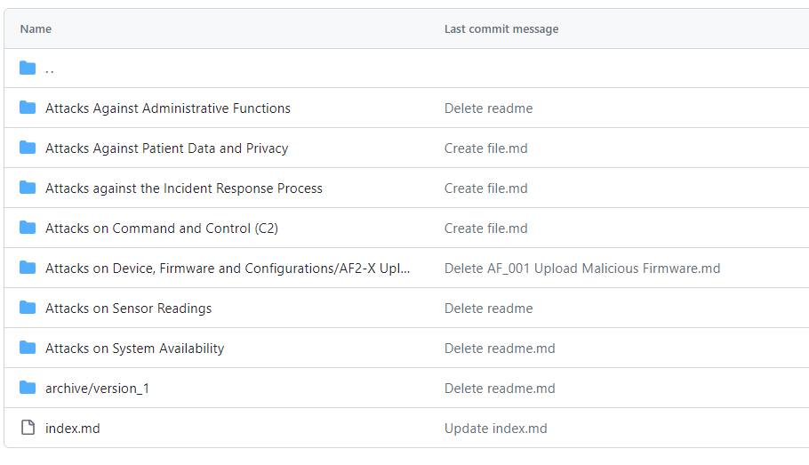
Github Repository

Slide 6
Member Recruitment
Members of automotive industry
OEMs
Tier 1 Suppliers
Automotive Cloud SaaS Vendors

Slide 7
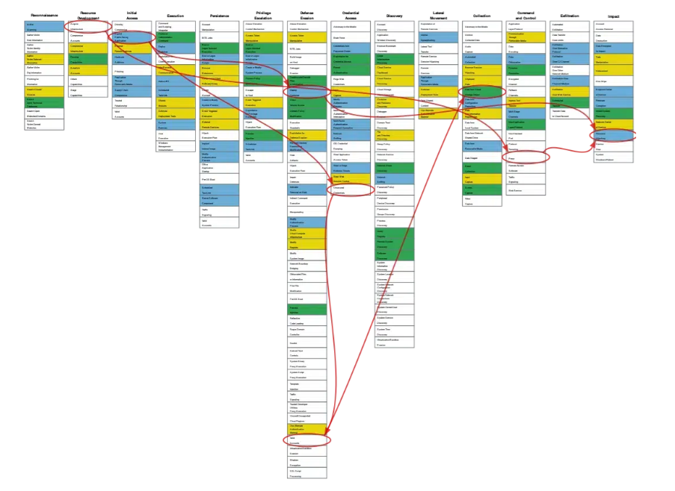
Attack Flow
MITRE Attack Flows v 2.0.0
Download builder tool @ https://github.com/center-for-threat-informed-defense/attack-flow/releases/tag/v2.0.0
Source: MITRE Enginuity @ https://mitre-engenuity.org/cybersecurity/center-for-threat-informed-defense/our-work/attack-flow/

Slide 8
Project Plan
1. Roadmap that defines evolutionary project scope
Levels of architectural detail
Begin with focus on cloud and cloud interfaces (L1 Architecture)
Vehicle as black box
Evolve to examine vehicular architectures
Evolve to include additional technologies
ML/ LIDAR/ etc
Hardware (ECUs/ OBUs, etc)
2. Catalogue real-world automotive attacks
3. Catalogue real-world attacks from other industries that may apply to Automotive
4. Define L1 Architecture
Vehicle is black-box
Interfaces to cloud
Cloud services; cloud processes
Assets/ high value assets
5. L1 Architecture Attack Flows
Create representative attack flow (example)
Build attack flows representing real-world attacks
Build attack flows representing theoretical attacks
6. Iterate through lower levels of detail
L2 and beyond architectures
Defined by roadmap

Slide 9
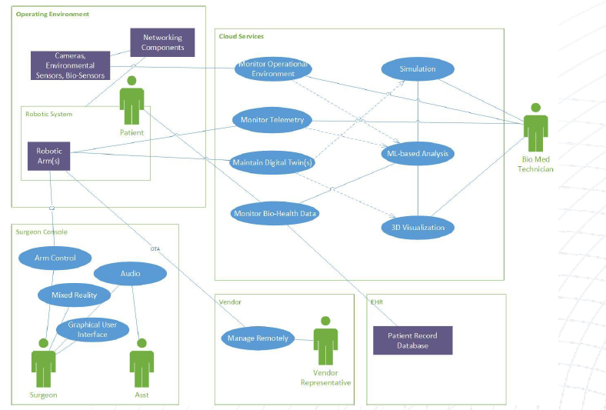
Define Representative Automotive Cloud Architecture
Generic components
Generic interfaces
Data types
Actors
Processes
End result provided shared understanding of automotive cloud
- Supports modeling of attack flows
Example: High Level RAS System Architecture
Source: CSA IoTWG TeleSurgery Guide Book

Slide 10
Attack Flow Use (Summarized from MITRE CTID: https://center-for-threat-informed-defense.github.io/attack-flow/introduction/
Adversary behavior is focus of attack flows
Action represents an adversary executing a specific technique.
Example: T1566 Phishing, although not necessary to use ATT&CK
Create sequences of adversary behaviors by connecting actions together
Can create parallel paths and use AND/OR operators
Asset objects indicate which objects are impacted by attacks and/or which objects are used in subsequent techniques
Assets can be services, devices, data, etc…

Slide 11
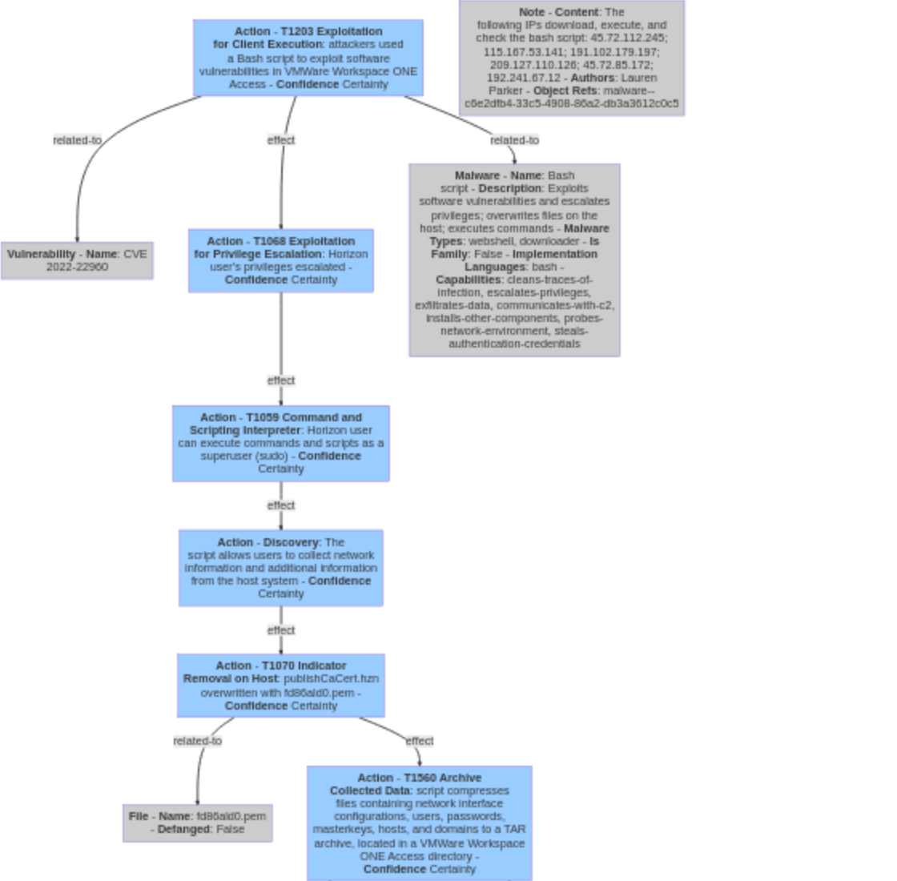
Example (real-world) attack flow
Example Attack Flow: Source: MITRE CTID

