Slide 1
Non - Fungible Token
Jyoti Ponnapalli

Slide 2
What is “non-fungible” asset?
Fungible asset
Oil
Penny
Bitcoin
Non-Fungible asset
Art
Title
Deeds

Slide 4
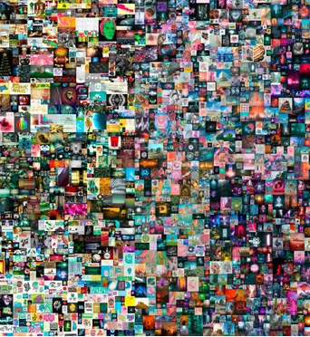

Slide 5
Use cases
Art
Certification
Collectibles
Physical assets
Tickets & Coupons
Art collectibles
Music
Gaming

