Slide 1
Crypto updates
CSA Blockchain Working Group
Ashish.Mehta

Slide 2
Notes from Chainanalysis Ransomware 2021 report
Average ransomware payment has TRIPLED in 3 years to $54,000
Increasingly private sector is being hit as much as public sector establishments
Known ransomware payments in cryptocurrency have rised by 337% in 3 years to over Half a billion dollars.
Huge sanctions risk possible (if company pays ransom to a sanctioned entity)
Ransomware attackers like Clop,Revil,Babuk,Darkside &netwalker profiled
RaaS model exploding in use
Money is going to Cryptoexchanges(70%),risky exchanges(20%),Mixing(balance)

Slide 3
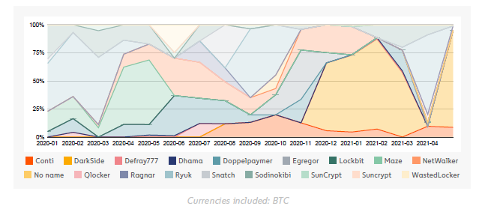
Ransomware lifecycles :monthly strains -2021

Slide 4
Some further points of observation
Globally there is a lack of an effective ransomware response plan to deal with attacks on SMEs/SMBs.
One of the biggest RaaS operators was Netwalker which was taken down in Feb 2021 by FBI.Over $10 million seized and a Canadian national arrested
4 Seperate roles that receive funding from such proceeds-Administrator(10%),Affiliate(80%) & two commissioned roles(10%).
They are buying storage space in cryptos
They are leaking data out even before ransomware is paid
Tremendous overlap among Affiliates across multiple ransomware strains
Russia affiliated actors received more ransomware than any other country in the world.Connected to the marketplace-Hydra

Slide 5
Governments go after Cryptos
China bans Financial firms from crypto transactions
China bans financial, payment institutions from cryptocurrency business | Reuters
US Government goes after Binance
Crypto exchange Binance faces investigation by IRS, Department of Justice: report (theblockcrypto.com)

Slide 6
Big Fabric and Corda developments
IBM Blockchain CTO and R3 Corda CTO leave for avenues that offer greater stimulation..
IBM Blockchain CTO departs with two key Fabric developers - Ledger Insights - enterprise blockchain
Moshe Hogeg and fraud ICOs
3 of Israel’s most-hyped initial coin offerings were scams, ex-employees allege | The Times of Israel
Turkey cryptoexchanges failed
Turkey’s Cryptocurrency Boom Turns to Bust - Bloomberg
Turkey’s Crypto Pain Grows With Second Exchange Collapse - Bloomberg
Dune Analytics Tools for ETH
DEX metrics 📊 (duneanalytics.com)

Slide 7
How do we arrive at a Fair Value for Cryptos???
Based on Use Cases?
Based on number of Transactions?
Based on which country /exchange supports it?
OPEN ENDED DISCUSSION!

