Slide 1
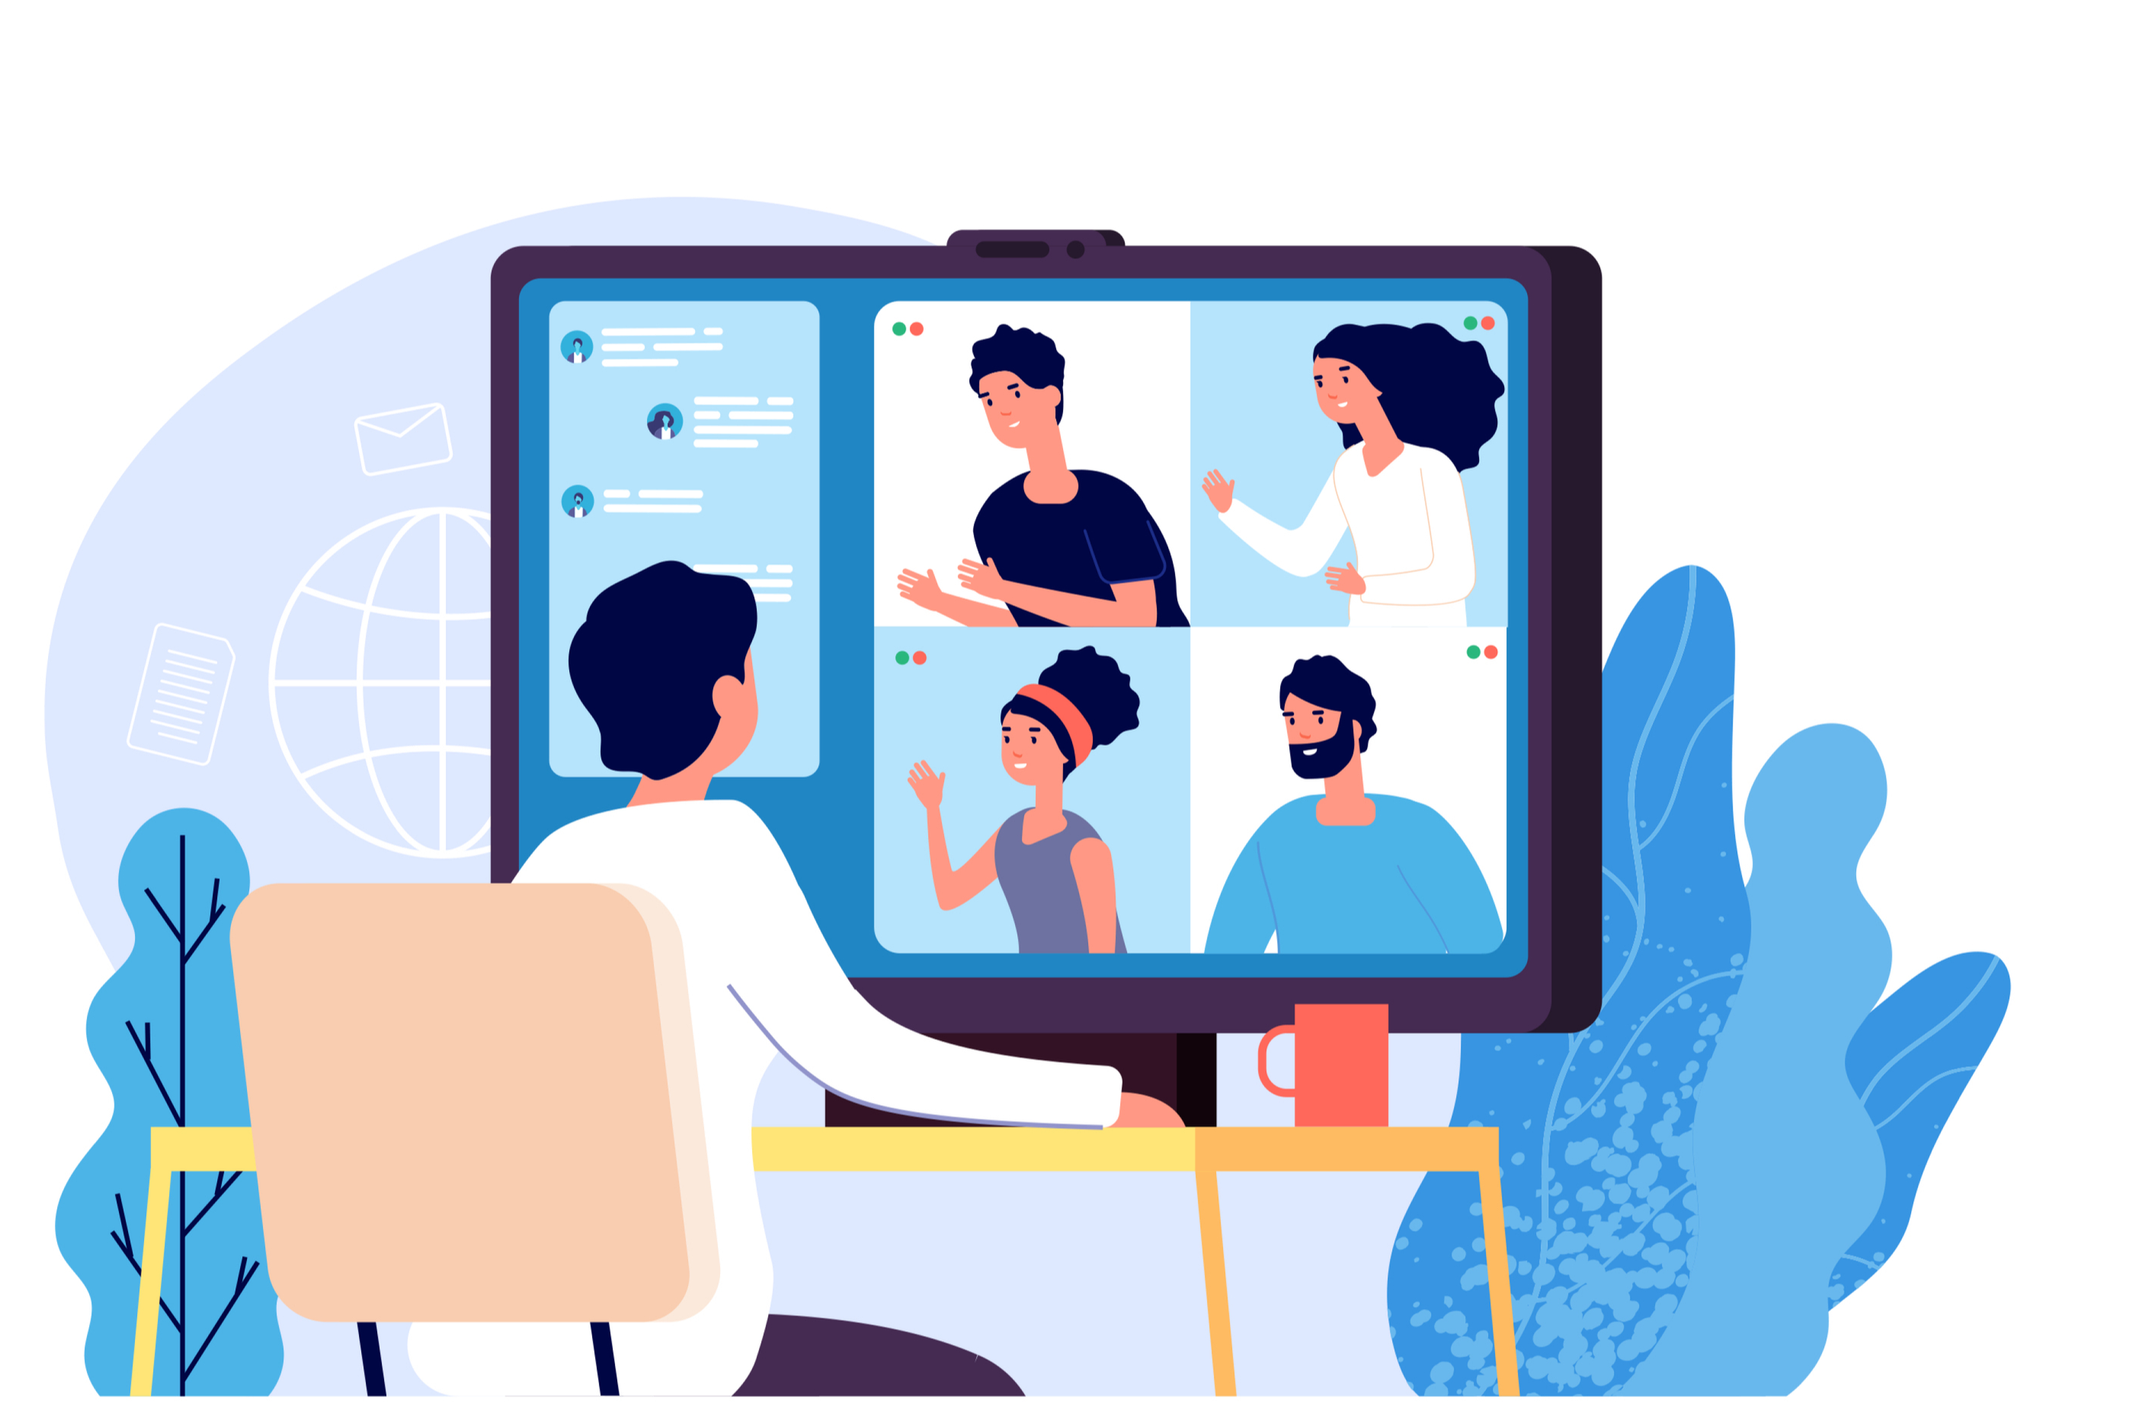
Video Conferencing Tips for Attendees
Update software
As organizations and individuals rush to work from home, video conferencing has become a key part of staying connected and working together. Here are key tips to making certain you are securely attending a video conference.
Make sure you are always using the latest version of the software. The more recent and updated your software, the more secure you will be. Enable automatic updating, and always quit your program when you are done as some programs update when you restart.
Configure audio/video settings
Set your preferences to mute your microphone and turn off your video when joining a meeting and enable them only when you want. You may want to consider placing a webcam cover or tape over your computer’s camera.
Double-check your background
If you want to enable your webcam, be aware of what is behind you. Ensure you do not have any personal information or family members walking behind you during the call. Some video conferencing software lets you set up your own virtual background or blur your background, so people can’t see what is behind you.
Don’t share invites
The invite link to a call is the ticket to enter the meeting; others can join if you share. Even if a trusted coworker needs the link, it’s much better to tell the conference organizer who can give the individual access to ensure changes to the conference are automatically shared with everyone.
Don’t take screenshots
Do not take or share screenshots of the conference call. You could accidentally share very sensitive information that should not be public.

