Slide 1
CSA DevSecOps Working Group
Kickoff Call will begin soon

Slide 2
Meeting will be recorded
We will have some time at the end for discussions outside of the recording

Slide 3
Introductions - CSA
Josh Buker
John Yeoh
Notes:
Hi everyone, I'm Josh Buker, a research analyst for the Cloud Security Alliance (CSA).
The CSA is a non-profit organization focused on bringing security experts together to further research and adoption of the cloud.

Slide 4
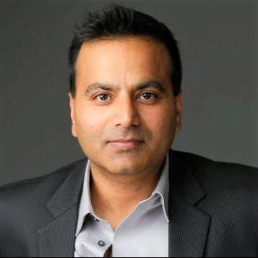
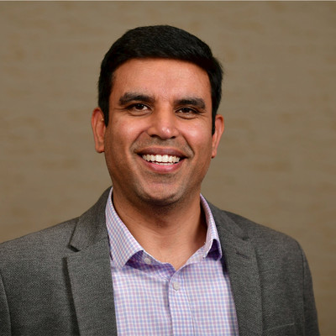
Introductions - Co-Chairs
Sam Sehgal
Kapil Bareja
Chris Kirschke

Slide 5
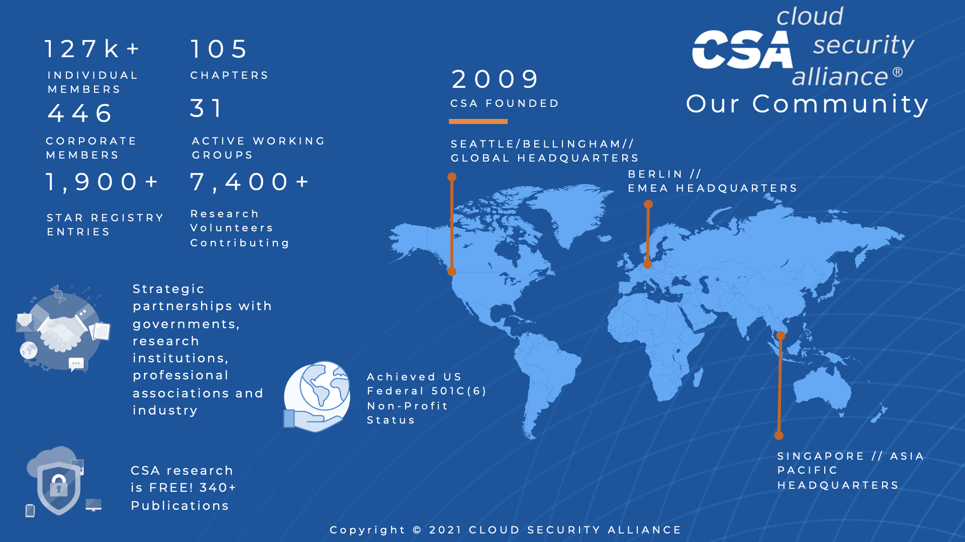
Why DevSecOps?
How does DevSecOps fit into the larger CSA Research Portfolio?

Slide 6
Why DevSecOps?
How does DevSecOps fit into the larger CSA Research Portfolio?

Slide 7
Why DevSecOps?
How does DevSecOps fit into the larger CSA Research Portfolio?

Slide 8
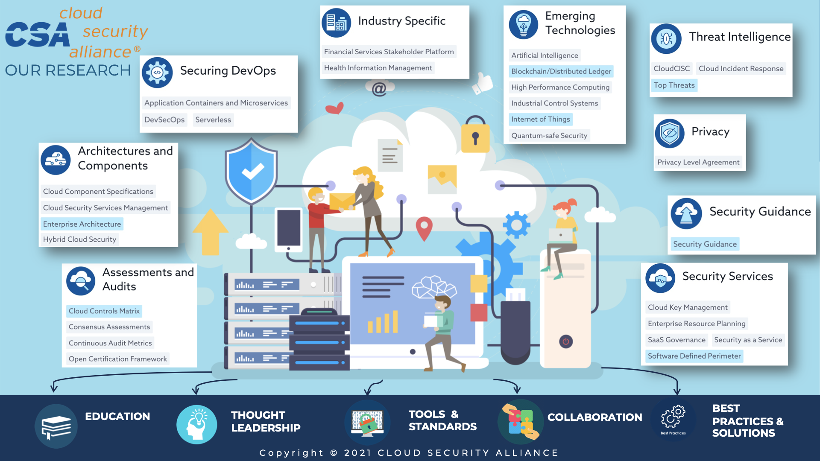
Why DevSecOps?
How does DevSecOps fit into the larger CSA Research Portfolio?

Slide 9
How are we approaching DevSecOps?
Six Pillars Series and beyond

Slide 10
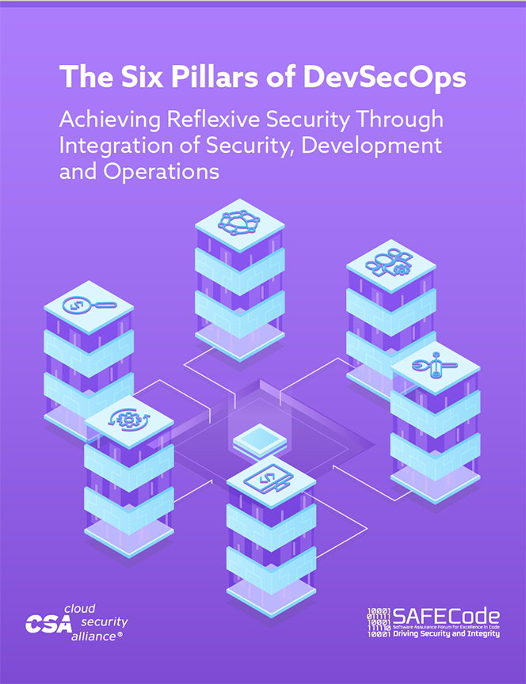
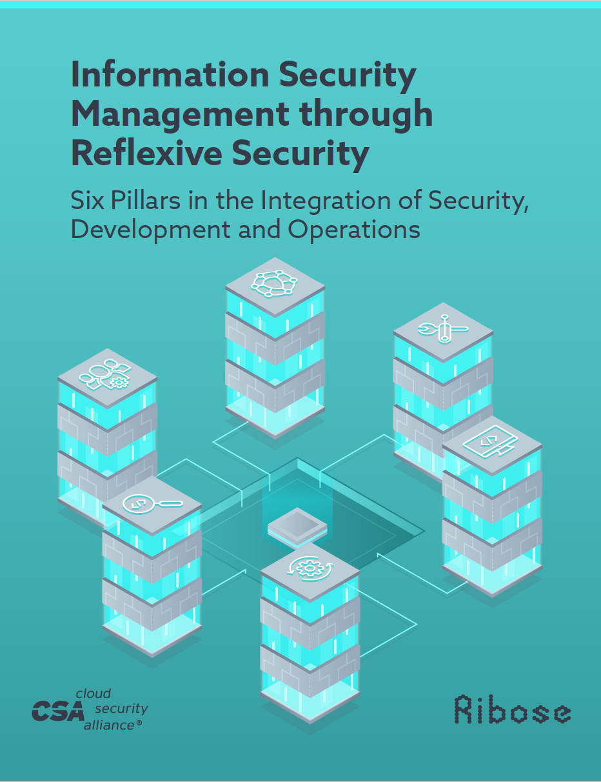
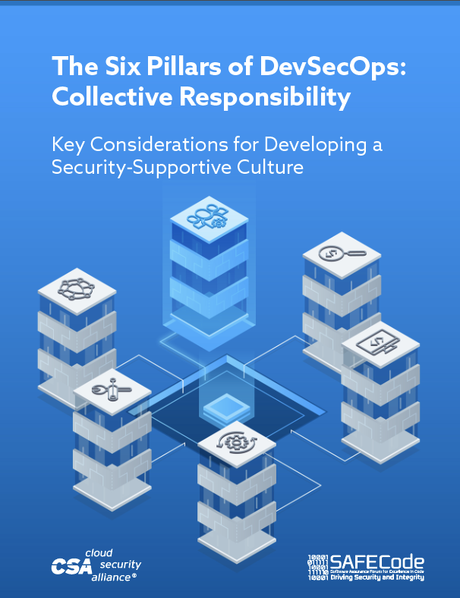
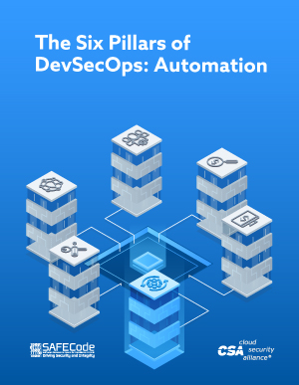
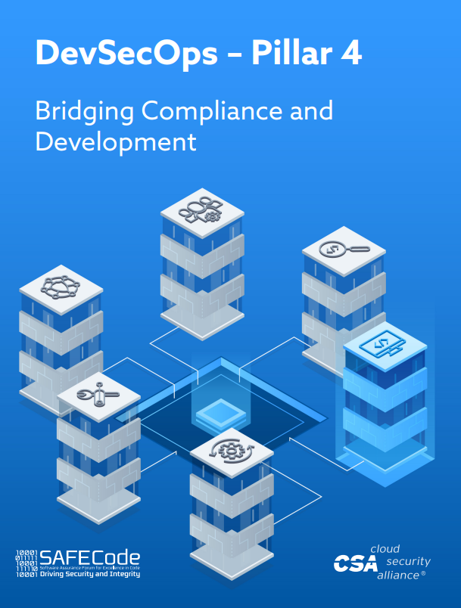
What we’ve done so far
2019 Aug
2019 Aug
2020 Feb
2020 Jul
2022 Feb

Slide 11
What comes after the Six Pillars Series?
“How do we see around the corner?”
Implementation Plans
Sample JIRA Initiatives, Epics, Stories, Issues
Consumable Frameworks
Sample list of controls in the form of CSV or Diagram format
Metrics
Board, Executive, Tactical level metrics with derivation formulas

Slide 12
What we’re working on now
Pillar 2 - Collaboration and Integration
Enormous knowledge and talent gap in the software landscape across Development, Operations and Security
Pan-organization collaboration necessary to achieve success in security implementation
A security aware and collaborative culture pre-requisite to report potential anomalies, such as - human error
Pillar 3 - Pragmatic Implementation
DevSecOps provides proliferation of point solutions
Distinct software life-cycle in each organization in terms of structure, processes and overall maturity make it difficult to find one-size fits all tool to implement DevSecOps
Organizations to rely on framework agnostic “Digital security and privacy model” and adopt a holistic view of software lifecycles security needs and future state they want to achieve;
This approach to enable security to be built into applications & software lifecycles that produce applications

Slide 13
What we’re working on now
Pillar 6 - Measure, Monitor, Report and Action
Actionable metrics required to measure progress and detect failures in a timely manner. Results during software development as well as post delivery must be measured, monitored, reported and acted upon by right individuals to contribute to DevSecOps success. Critical metrics necessary to monitor in DevSecOps environment include:
1- Deployment frequency
2- Vulnerability patch time
3- Percentage code automatically tested
4- Automated tests per application

Slide 14
What can you do to help?
Download and read the existing pillars: https://csaurl.org/devsecops-six-pillars
Sign up for the working group: https://csaurl.org/devsecops-signup
Join the Slack channel: Email jbuker@cloudsecurityalliance.org
Attend the monthly meetings - Next meeting May 26th, 8am Pacific

Slide 15
Q&A

Slide 16
Thank you!
We will have a section after the recording for discussion outside of the recording.

