Slide 1
CordaCon 2021 Highlights
Michael Theriault

Slide 2
Agenda
CordaCon Overview
What is Corda?
Corda 4 Lessons Learned
Corda 5
Conclave

Slide 3
Fair USE Notice
This presentation and content made available through this site is for educational purposes only.
This presentation may contain copyrighted material owned by R3, the use of which has not been specifically authorized by R3. Notwithstanding a copyright owner’s right under the Copyright Act, Section 107 of the Copyright Act allows limited use of copyrighted material without requiring permission from the rights holders, for purposes such as education, criticism, comment, news reporting, reaching, scholarship, and research. These so-called “fair uses” are permitted even if the use of the work would otherwise be infringing.

Slide 4
About CordaCon 2021
3 Days on September 28 – 30th
Hybrid conference
First day was held on-site in London, UK
2nd and 3rd day virtual
This year’s theme: Digital trust, delivered
113 Sessions – All sessions are available online and on-demand
https://www.CordaCon.com

Slide 5
Session Breakdown - Tracks
Business (32)
Startup (36)
Technology (31)

Slide 6
What is Corda?

Slide 7
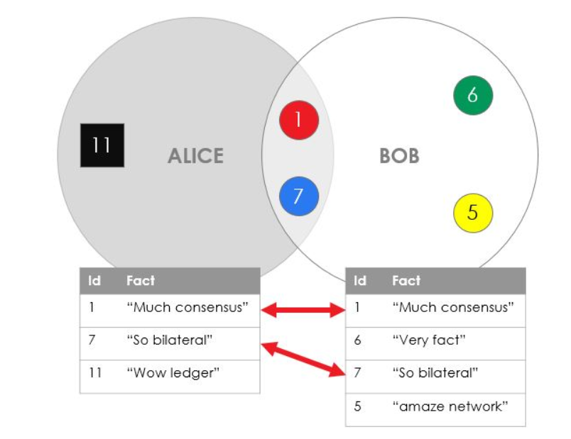
What is CordA?
A solution that abstracts the complexities of conducting transactions on a private permissioned network between parties by reaching a consensus about shared facts on a ledger
No single central store
Each node maintains its own database of facts
No peer is aware of the ledger in its entirety
The Corda Ledger is a subjective construct from each peer’s point of view.
There are no omniscient peers who can see everything on the ledger.
Each node sees their own facts, and the facts that they share with others.
There is no central or general ledger operating with agency on ﻿behalf of all the nodes on the network

Slide 8
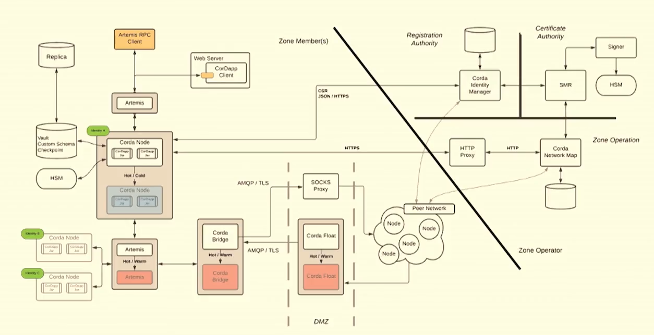
Corda 4 Enterprise Deployment Architecture

Slide 9
Everything is an asset
Digitalization of everything makes everything financial
As things becomes digital, almost anything can become an asset
Very odd secondary markets are being created
What’s driving this?
Interconnected world
Cultural becoming financial
Digitization itself
NFT (Non-Fungible Token) Digital objects being represented as scarce
Everything can become an asset!
The definition of an asset will expand beyond today’s conception

Slide 10
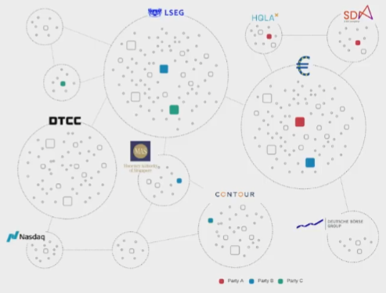
Demand for modernization
Market infrastructure
Financial market grade trust technology
R3 is meeting this demand by developing Corda and Conclave
Private
Secure
Scalable
Invisible
Significant time and investment made into the interconnectivity and bridges into other networks
Corda Settler
Corda Payments

Slide 11
Corda Product roadmap

Slide 12
Corda Product roadmap

Slide 13
Digital Currency sandbox

Slide 14
Corda payments

Slide 15
R3 Lessons Learned From Corda 4
There was some success with critical applications/business networks, but other customers struggled with the time to market for their solutions.
Improve scalability and resiliency for critical infrastructures that leverage Corda
Cordapp development and infrastructure deployment is difficult and expensive
Need to reduce infrastructure costs
Progressive decentralization trend was observed not only on Corda networks but other networks as well.

Slide 16
Objectives for Corda 5
Faster & Cheaper application development time for faster conversion of projects
Lower cost of operations for larger array of operating models for more profitable use cases
Powered by a highly available and horizontally scalable architecture

Slide 17
Corda version 5 Key Concepts
Application Networks
Application centric & optimized for permissioned multi-party app networks
Modular APIs & Developer Productivity
Improving testability & enabling new use cases
Event Driven Workers
The new “brain” of Corda for availability & scalability
Virtual Nodes
Logical equivalent to C4 nodes, multiple nodes per cluster multi-network or tenancy
Composability
Composable applications bundles (combining applications to work on one ledger) within application package boundries
Interoperability
Interoperable applications networks

Slide 18
Corda 5 Application Networks
Why? Reducing the number of steps needed for a software vendor to convert a prospect into a live participant
Current
Deploy the node infrastructure
Obtain data needed to join the network
Obtain the cordapp jar files
Deploy the stack that interacts with the nodes

Slide 19
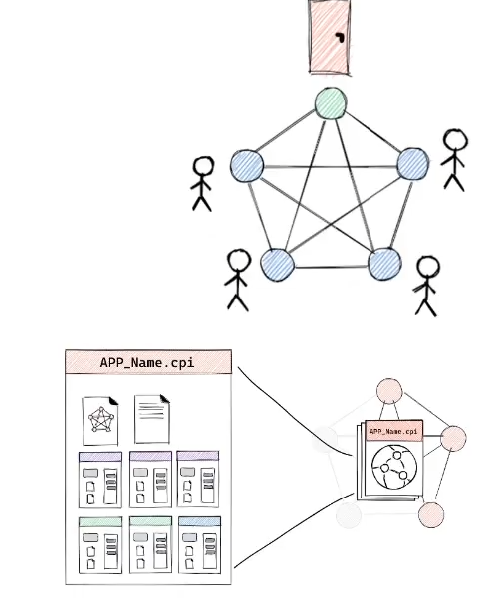
Corda 5 Application Networks
Future State
Network of virtual node peers
Permissioning is managed by a peer via a platform application (Membership Group Manager)and will replace the Corda Enterprise Network Manager (CENM)
Network and apps are defined by and installed from a single
artifact (installer)
Applications are loaded from the installer
Network details taken from the installer itself
Prompt for mandatory or optional upgrades
Membership requirements are defined in the installer
Why?
Less upfront coordination
Makes it simpler to manage the network

Slide 20
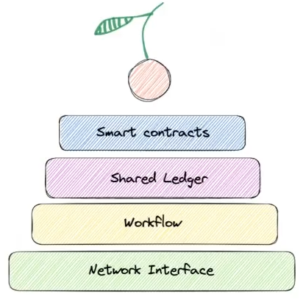
Corda 5 Modular API & Dev Productivity
A layered cake approach
Network interface: Secure networking and peer interactions
Workflow: Data agnostic, decentralized API to coordinate actions across parties
Shared Ledger: Reliable data management agreement between parties (WYSIWIS)
Contracts: Decentralized enforcement of business logic
New Development Tooling / HTTP RPC API
Why?
Improve testability of applications (e.g., mocking workflow logic only)
Improve Developer experience
Enables net new use cases (workflow or contract first applications)
Future proof platform development (ability to evolve layers independently)

Slide 21
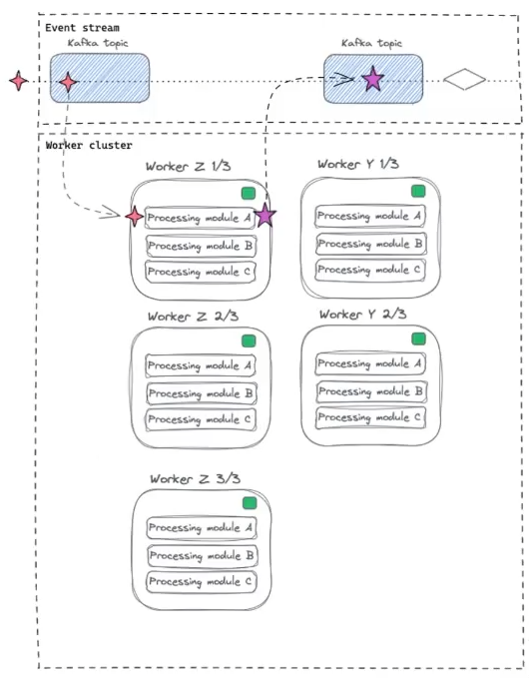
Corda 5 Event Driven Workers
A worker is an instance of a Java Virtual Machine (e.g., running in a Docker container) containing a group of processing modules/services
Multiple instances of the same worker
A worker picks up tasks from an event stream and processes it
Workers can be parallelized to help with throughput or availability
This is the new brain of Corda
Why?
Container & orchestration first deployment
High availability & horizontal scalability
In the future, dynamic scalability (for activity bursts)

Slide 22
Corda 5 Event Driven Workers

Slide 23
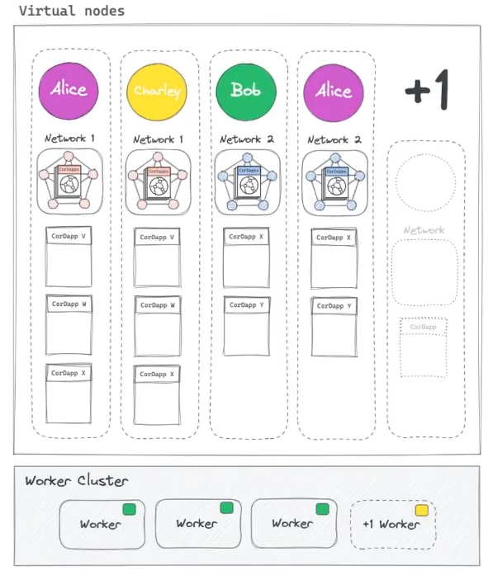
Corda 5 Virtual Nodes
Virtual nodes represent the mapping between processes, data & identity to create a logical “virtual” node
Corda 5 virtual node able to represent the equivalent of multiple Corda 4 nodes
One Corda 5 worker cluster can host multiple virtual nodes
Segregated and isolated from each other using sandboxing technology
Multi-network and/or multi-tenant
Why?
Flexible operating model (distributable SaaS)
End users can be in more than one network
Lower cost to add an end user
Maintains isolation
Portable

Slide 24
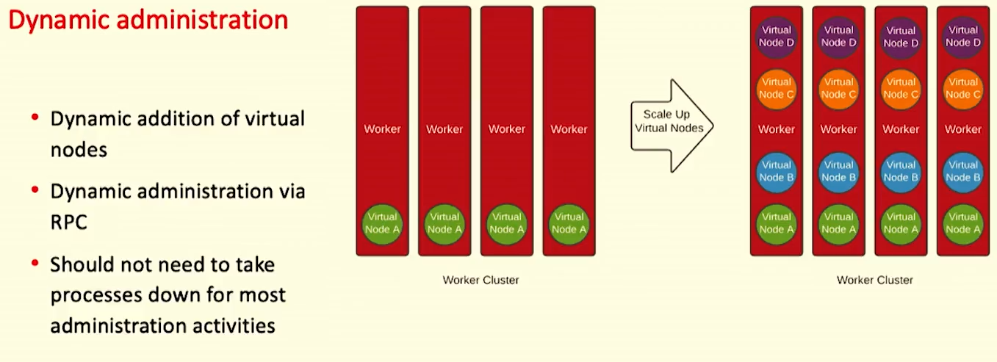
Corda 5 Virtual Nodes

Slide 25
Peer-to-peer networking
HTTPS is the new high-level Peer-to-Peer transport
Provided by new component, Corda Gateway, removing need for firewall
Based on lessons learned from security and deployment teams
Now aligns well with security team expectations and existing enterprise infrastructure
TLS 1.3 encryption, standard web certificates
Facilitates deep packet inspection
Removed TLS authentication
Authentication is server only
Allows TLS termination on firewall load-balancer
End-to-end authentication layered on top of published security protocols

Slide 26
Peer-to-peer networking

Slide 27
RPC
New HTTPS / JSON RPC
Replaces bespoke Artemis / JVM-specific RPC. Currently special translations are needed to convert HTTP to RPC
Easier to access from non-JVM platforms like web applications
Common pattern was to have web server “translation layer” – no longer needed
Support for OpenAPI
Support for single-sign-on (SSO)
Swagger descriptors of the API/Postman
Durable streams
Reliable event stream
Modelled after Apache Kafka – with poll of page of data, and a position in the stream
Designed for reliable integrations with external systems vis RPC (HTTPS / JSON)
Solves reliability problems of observables and RPC client in Corda 4

Slide 28
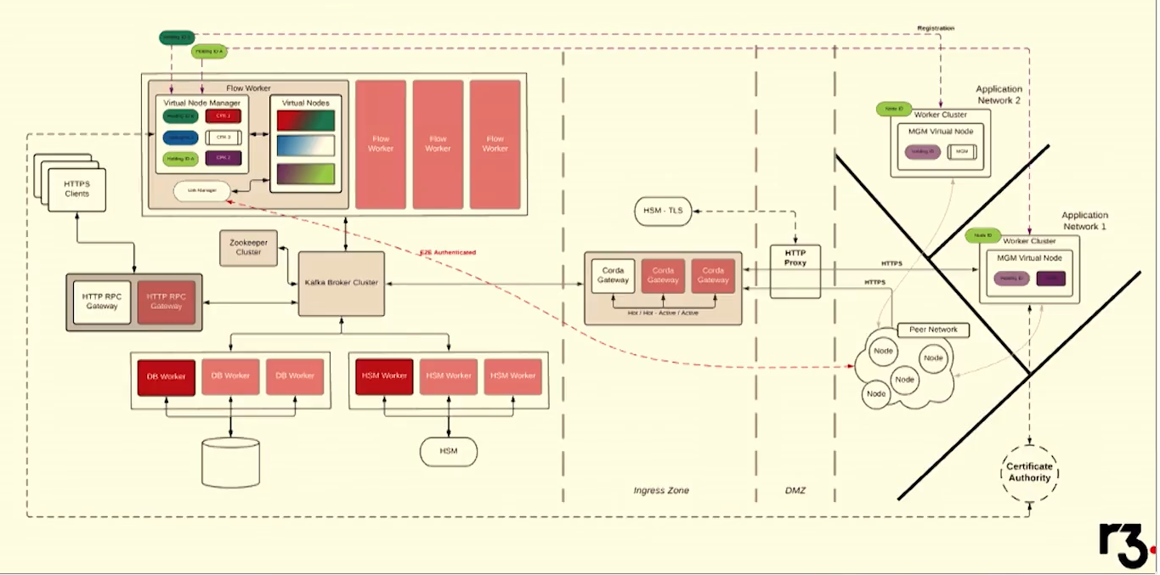
Corda 5 Architecture

Slide 29
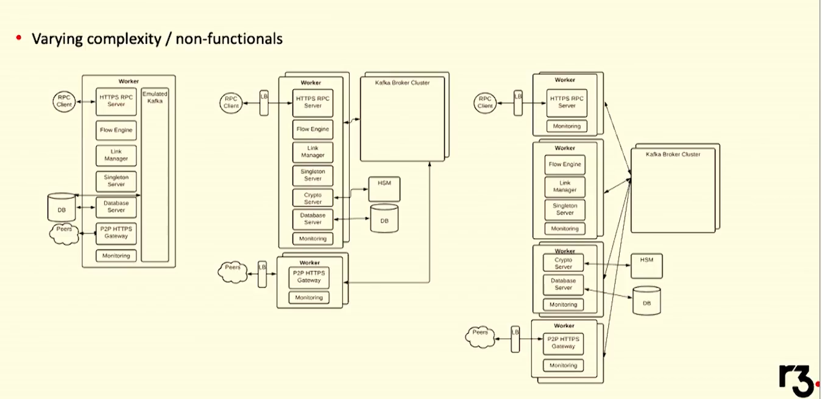
Corda 5 PRODUCTION DEPLOYMENT Topologies

Slide 30
Corda 5 PRODUCTION DEPLOYMENT Topologies

Slide 31
CLI

Slide 32
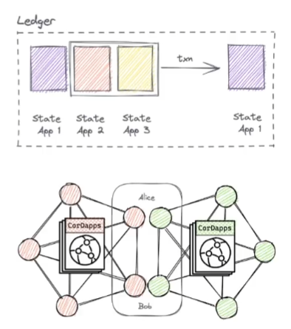
Corda 5 Composability & Interoperability
In Corda 5, the same work cluster can power different virtual nodes participating in different application (networks)
An application provider can thus market the 5.x install base at a lower conversion cost
Applications can work alongside each other:
(App Composability) Either by bundling applications together in one lead CPI can share the same ledger
(App Interoperability) Or by leveraging an interoperability protocol between application networks.
Under the control of one application publisher
The publisher confirm Cordapps will work together safely, packages them together, and issues them to their customers
Allows upgrade in lockstep (all Cordapps in the package are upgraded together)
Network operator always knows what applications are running on their network
Based on Open Service Gateway Initiative (OSGI) - a specification defining a Java-based component system
Why?
Independent networks working together safely
Less upfront coordination for interoperability (leaving market incentives dictate the pace)
Composability made safer with application bundles

Slide 33
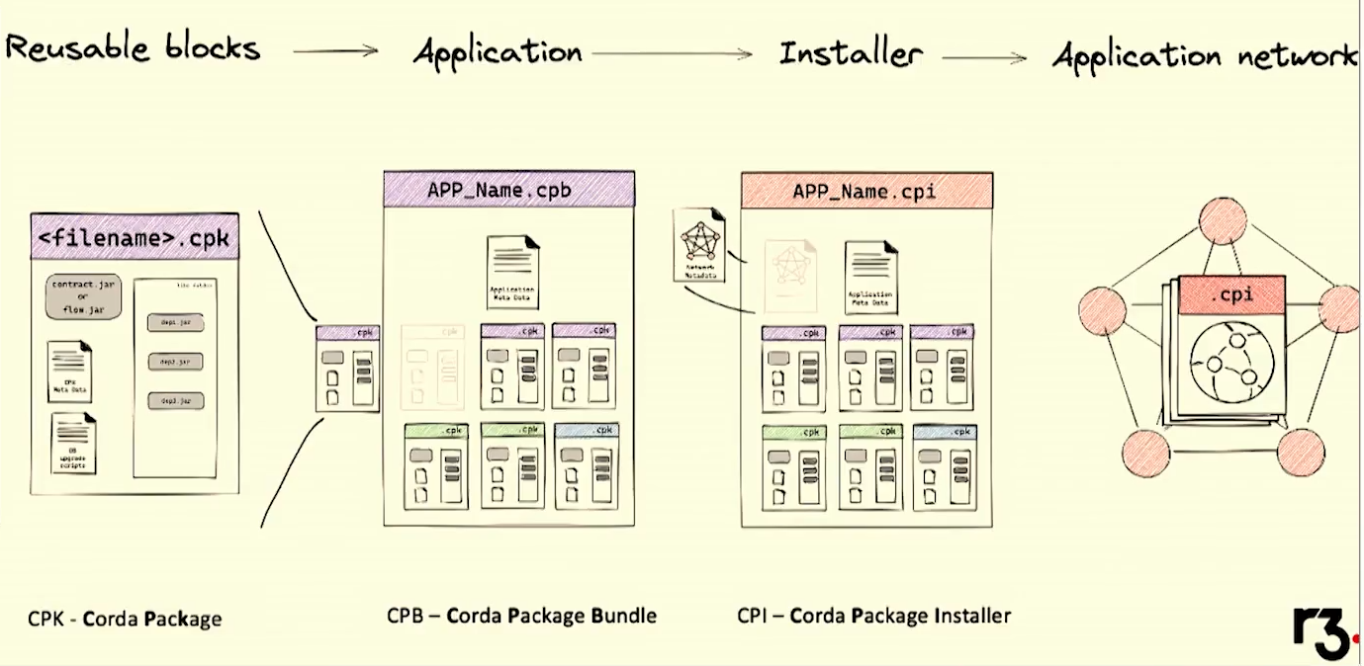
Corda 5 Packages, bundles, and installers

Slide 34
Corda 5 Packages, bundles, and installers

Slide 35
Network of networks

Slide 36
Conclave – What is it?
Confidential computing – it is a promise that allows users to share their data in a way that they can then be confident in how that data is going to be used.
Intel SGX (Secure Guard Extension) Trusted Execution Environment provides a cryptographic attestation that this is the code that is running, and it is in a secure tamper-resistant environment
Intel SGX Remote Attestation provides technical assurance of the following:
Client is connecting to SGX
Software is patched with latest security updates
Process is running verifiable algorithm
In summary, an enclave is a small program which can run on an untrusted computer, where the operator of that computer cannot affect the integrity of the code nor observe the data that passes in or out.

Slide 37
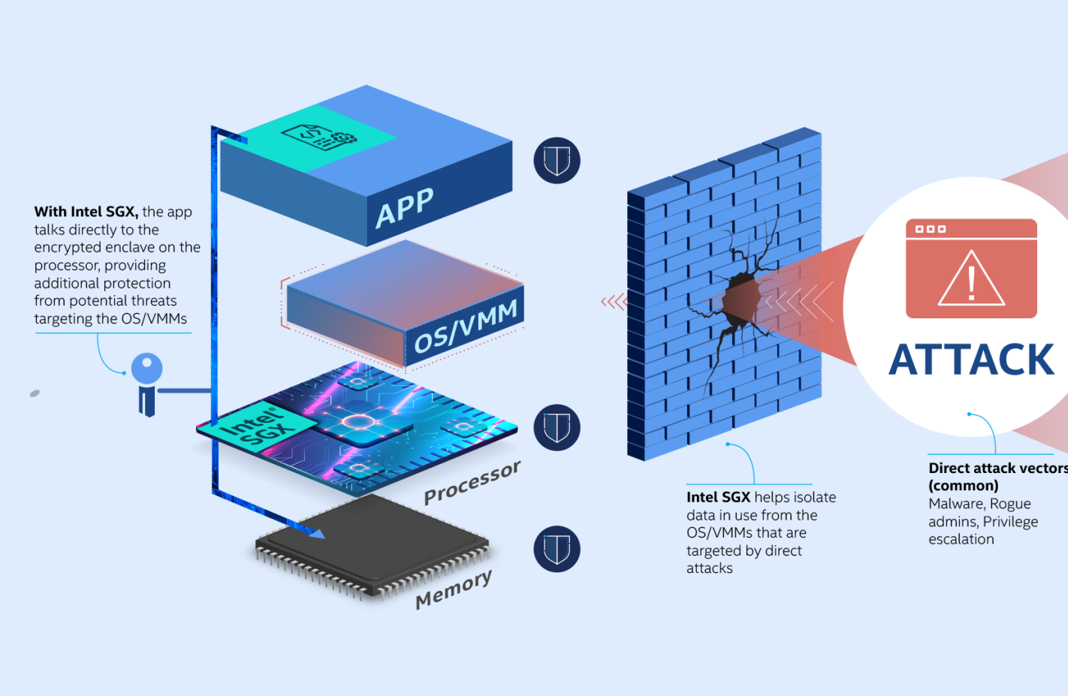
Conclave Architecture
Intel SGX is an implementation of enclave-oriented computing
An enclave is a region of memory which the CPU blocks access to, running inside an ordinary process which we call the host
The region contains both code and data, neither of which can be read or tampered with by anything else
Code executing inside this region has access to special CPU instructions that give it a variety of useful abilities.
Enclave memory is protected both from the rest of the code in that process, privileged software like the kernel or BIOS, and because the RAM itself is encrypted even physical attackers
This means a remote computer can trust that an enclave will operate correctly even if the owner of the computer is malicious.
Intel® Software Guard Extensions Protects Data

Slide 38
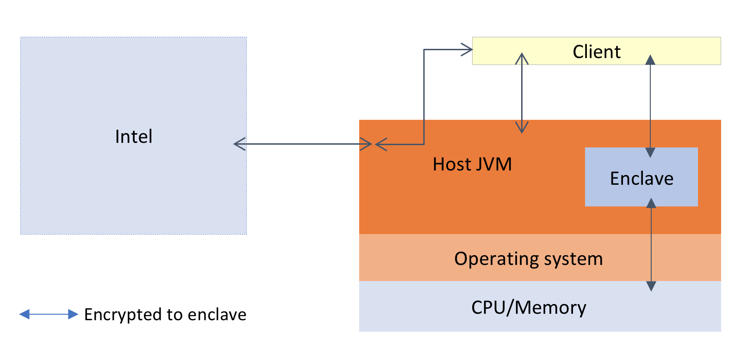
Conclave Use Cases
Process private data without being able to see it yourself, to enhance your user's privacy
Create a hardware-backed form of zero knowledge proofs: make trustworthy 'statements' that a particular computation was done on some data, without the data itself needing to be revealed
Outsource some kinds of computations to an untrusted cloud
Improve the security of a server by restricting access to a whitelist of client enclaves, blocking attempts to send malformed packets and messages that might come from hackers.
Make your service auditable only by users who want high assurance - those who don't care can simply ignore the infrastructure entirely.
Conclave Architecture - Conclave documentation

Slide 39
Conclave Roadmap

Slide 40
Thank you!

