Slide 1
Video Conferencing Tips for Organizers
As organizations and individuals rush to work from home, video conferencing has become a key part of staying connected and working together. Here are key tips for securely hosting a video conference.
Update software
Make sure you are always using the latest version of the software. New security features and bug fixes are constantly being released. The more recent and updated your software, the more secure you will be. You can do this by enabling automatic updating. In addition, always quit your program when you are done with it and restart it the next time you want to use it as some teleconferencing software updates every time you restart it.

Slide 2
Require a password for entry
One of the most effective ways to protect the privacy and security of your conference is to require a password for people to join. The password can often be included in the conference invite, making it easy for people to securely join.
Review attendees
Review the people attending your event. If there is someone you do not know or cannot identify, have that person confirm their identity. If you have any concerns, remove them from the conference.
Lock the conference
Many solutions offer the option to lock the conference once it has begun, so no one else can join unless you manually allow them.
Eliminate disruptions
Remove disruptive or rude participants immediately.
Configure audio settings
Set your event’s default settings to mute participants’ microphones upon entry. Enable audio individually to avoid unwanted disruptions or background noise.

Slide 3
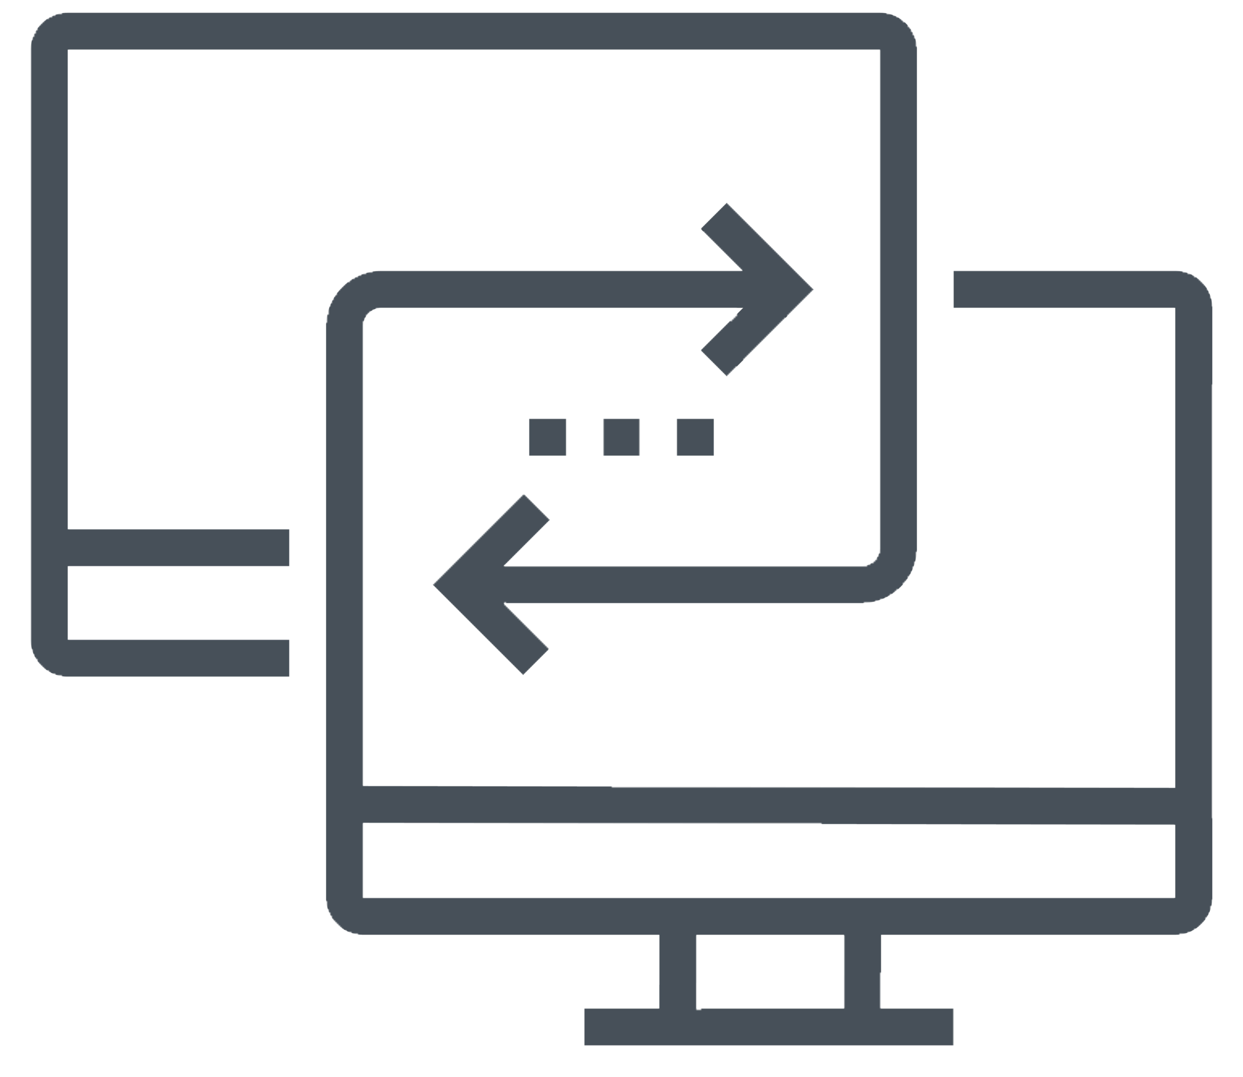
Double-check before you screen share
Exit all other applications and remove any sensitive materials from your computer’s desktop. This helps ensure you don’t get any distracting pop-ups on your screen or accidently share any sensitive or embarrassing information. Consider only sharing the app screen and not your entire desktop.
Clean up your background
If you want to enable your webcam, be aware of what is behind you. Ensure you do not have any sensitive or personal information or family members walking behind you during the call. Some video conferencing software lets you set up your own virtual background or blur your background, so people cannot see what is behind you.
Inform if recording
If you will be recording the event, make sure everyone on the call is aware you will be recording before you start..
Disable screenshots
Do not take or share screenshots of the conference call, as you could accidentally share very sensitive information that should not be public. As an organizer you may be able to disable anyone attending your conference from taking screenshots as well.

