Slide 1
CSA IoT WG Monthly Meeting
February 2022

Slide 2
Agenda
Guest Presentation (MITRE Hardware Security)
Intro, news, update on projects
Medical Device Cloud Security
Github for IoT Controls
Plan for Zero Trust Paper Completion
New project management tool for our WG

Slide 3
Medical Device Cloud Security
Purpose:
1. Provide a set of security patterns that MDMs and CSPs/ SaaS partners can use to securely design AI/ML-based medical devices.
2. Provide HDOs with a way to objectively understand and measure the security of any given AI/ML-based medical device product offering.
Goals:
Define one or more cloud-based medical device reference architectures
Create a threat model based on defined reference architectures
Identify cyber security controls to mitigate identified threats
Assign responsibilities using a RACI format to each identified control
Additional efforts may be undertaken after identification of controls, including but not limited to:
Definition of a comprehensive security architecture
Creation of security as code artifacts using tools such as Terraform

Slide 4
Project Plan Tailored to Stakeholder Views
MDM Consumer:
Use Case(s)
Reference arch
Threat model(s) (to augment the existing MITRE Threat Modeling playbook)
Cloud security pattern(s) with Shared Responsibility Model (MDM, HDO, HER, FDA, Patients)
HDO/EHR/Patient Consumer (who within?; architecture teams;
Tailored Guidance (checklist) based on Shared Responsibility Model for each stakeholder
Next Steps:
Define Use Case for Robotics / Tele-Surgery
Identify vendors to brief our group / participate

Slide 5
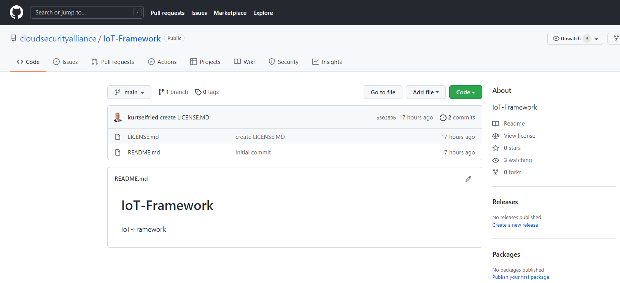
Github for IoT Controls
cloudsecurityalliance/IoT-Framework: IoT-Framework (github.com)
Moving spreadsheet-based content online
In line with other projects
NIST
OWASP
Volunteers needed to help transition

Slide 6
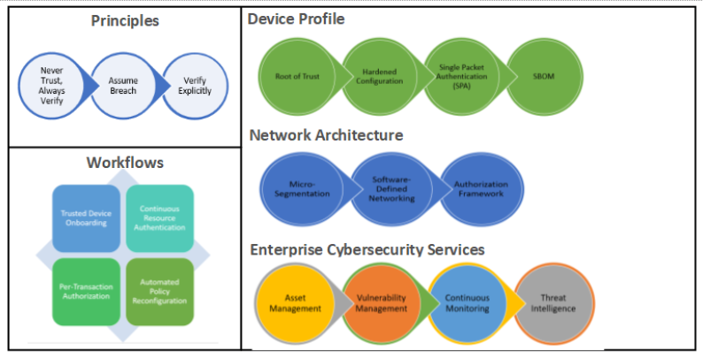
Zero Trust Paper
Need to plan completion
Volunteers to review existing content?
Volunteers to author /update content?
Device Security Profile
Enterprise Security Services
Asset Management
Continuous Monitoring
Threat Intelligence
Vulnerability Management
Workflows
Device Onboarding
Device Authentication/ Authorization
Human-to-device authentication
Automated Response and Recovery
https://docs.google.com/document/d/1hQV47T1wc9XCo5A5gbriMN1SJkiIV6QAOZoI99gM-RI/edit#heading=h.bh3r97vwt1xf

Slide 7
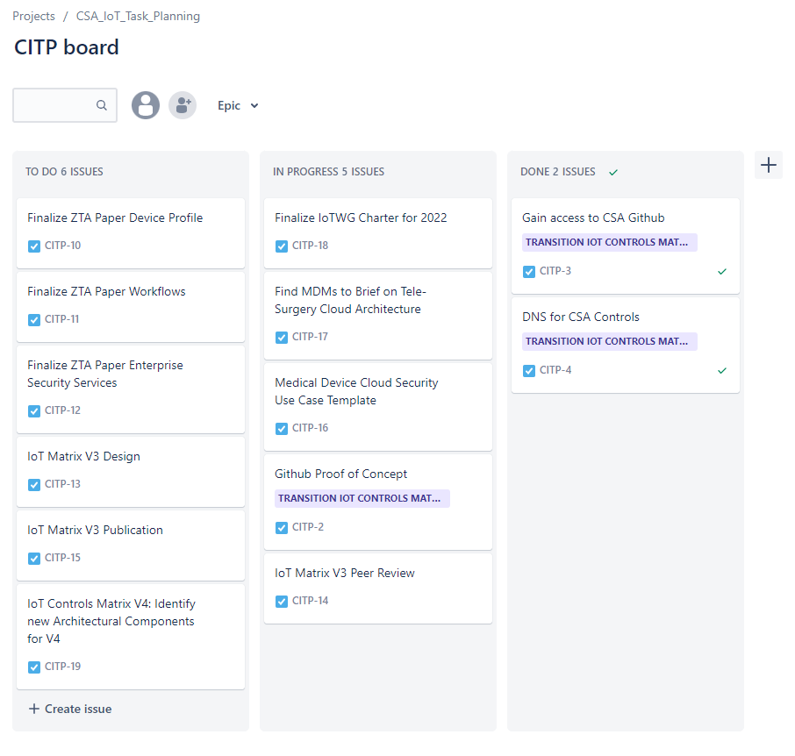
New Project Management Tool
https://trustthink.atlassian.net/jira/software/projects/CITP/boards/17

